Slide 1
Deeper Investigations of the Standards: Iowa Core Mathematics
Grades 6 – 8, Day 1
Iowa Department of Education
In Partnership with
AEA School Improvement
Notes:
1
1
If you want, point out the backing of both DE and AEA in this work for the IC

Slide 2
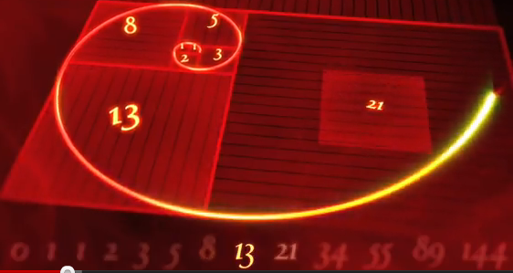
Why do you teach math?
http://www.sciencekids.co.nz/videos/math/numbersofnature.html
Notes:
Talk at your table for 1 minute about this question
To get kids to think outside the box?
To get kids to dream?
To get kids to …..

Slide 3
Welcome…
… a few logistics …
Notes:
Restrooms
Breaks
Lunch

Slide 4
Ground Rules for Today
Information-Giving
Group Work & Recording
Attentive listening
Open mindset to receive new ideas and information
Note-taking
Open mindset
Professional conversations
Careful note-taking (for taking back)
Deep thinking
Record questions – to be addressed later
©2011 Cooperative Educational Service Agency (CESA) 7 School Improvement Services Permission is granted to the Iowa State Department of Education for dissemination and use in any whole or part in any form within the state of Iowa region.
Notes:
We have 2 types of work today. You will be receiving information, but also working as small groups to investigate the IC Math document. In order to do all this work, we have some ground rules.

Slide 5
Iowa Core Mathematics Journal
OMJ
Notes:
A journal can be electronic or paper/pen
3-2-1 Feedback & journal prompt sticker
3 New ideas
2 Things I will use
1 Question I still have

Slide 6
A journal will be helpful for you to:
OMJ
Take personal notes
Respond to prompts during activities
Have a permanent record of your thoughts where you can return to reflect on them
Become an active participant in your own learning by engaging in an interaction with the subject or content area
Get involved in an active intellectual process in which you decide what is important and what is meaningful or relevant to you.
Adapted from “How the Brain Learns Mathematics” by David A. Sousa, Corwin Press, 2008
Notes:
Go through these reasons with the participants to explain the importance of writing as a learning tool
These will be collected after each investigation day then returned to you
These are a requirement for credit but an expectation for all

Slide 7
Begin to write…..
OMJ
Think
Reflect on your learning from the first day of “Investigating the Standards”.
Ink
Write in your journal about any questions, thoughts, or comments you have at this point.
Notes:
This is a time for the participants to think back to day 1. What do you remember, what do you still have questions on, what would you like to learn more about? This will be the first writing in their journal. Allow 3 – 5 minutes.

Slide 8
Begin to Converse….
OMJ
Pair
With a partner, share what you wrote.
Share
What comments or questions would you like to express with the entire group?
Notes:
After allowing enough time to write, have people partner up to share what they wrote (not necessarily word for word). After each person has shared, invite sharing of anything people would like to have the entire group hear.

Slide 9
OMJ
Learning Goals for
“Deeper Investigations” Professional Development
Understand that the structures of the Iowa Core Mathematics are meant to support focus and coherence
Understand that fluency, deep understanding, application and dual intensity support rigor
Understand how to investigate the Iowa Core Mathematics
Notes:
These are the goals for this day’s work for the participants here.
Developing a set of learning goals for a course takes what faculty know but don’t always state and puts it into a short list of real concepts that can guide participants and add clarity to teaching and learning.

Slide 10
Success Criteria
OMJ
I can describe at least four of the standards for mathematical practice.
I can connect the critical areas for my grade level to the specific standards at my grade level.
I can explain the big ideas of content within the domains at my grade level.
I can describe “mathematical understanding” by explaining how Rich Tasks support it.
I can describe how Iowa Core Mathematics provides a structure to change teaching and learning.
Notes:
Explain that these will appear again at the end of the day. At that time, you will see if you have met them or are part way there.

Slide 11
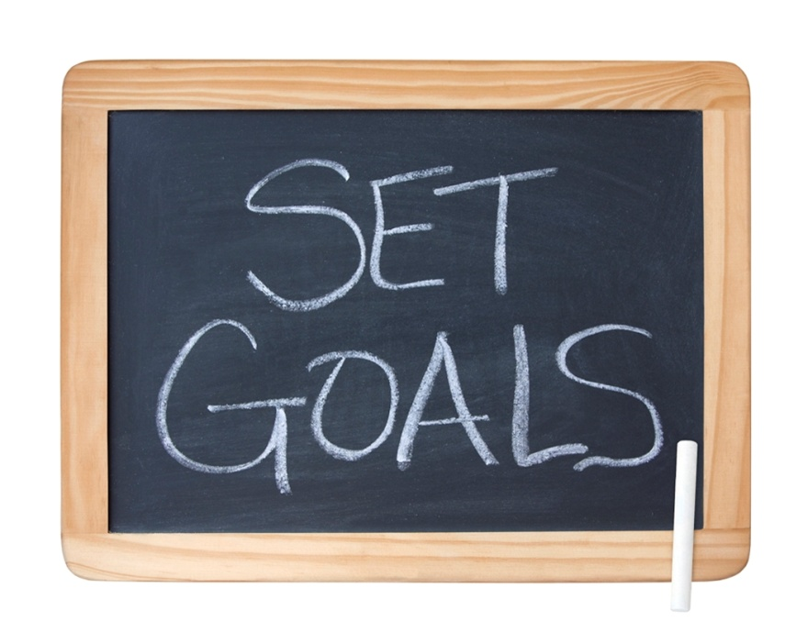
In your journal…
OMJ
Write down your own personal learning goal(s) for Iowa Core Mathematics.
Notes:
Give participants time to create their own personal learning goals and success criterial for their work in IC Mathematics. Give the option of students sharing their writing with others. Also remind participants that they can revisit these goals and success criteria to map their progress and also to alter the goals or success criteria.
Although participants can use the goals that are established for this professional development, they need to adapt them or to create goals that are uniquely theirs and that will reflect what they want to attain not only during this professional development but also to continued work in Iowa Core mathematics.
Reflect on:
your professional development plan
your math content knowledge
your math pedagogy
your students needs and learning
whatever will focus you on making your learning goals.

Slide 12
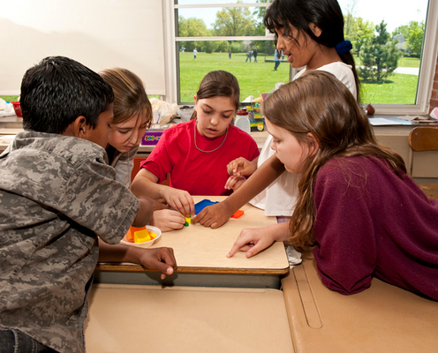
Rich Mathematical Tasks
As stated in IC, “Mathematical understanding and procedural skill are equally important, and both are assessable using mathematical tasks of sufficient richness.”

Slide 13
Rich Mathematical Tasks
By teaching through rich mathematical tasks, students develop deep conceptual understanding and skill proficiency. Rich mathematical tasks involve:
Emphasize connections across mathematical content areas, to other disciplines, and especially to the real world
Are accessible yet challenging to all
Can be solved in several ways
Encourage student engagement and communication
Encourage the use of connected multiple representations
Encourage the appropriate use of intellectual, physical, and technological tools
13
13

Slide 14
Selecting Tasks
Levels of Cognitive Demand
Multiple Entry and Exit Points
Notes:
Reminder: Le less helpful (Dan Meyer)
Use as example: When is it a task and when it is a non-task?
Levels of cognitive demand:
This is the first and foremost considerations- is the task cognitively demanding?
Higher order thinking tasks involve connection making, analyzing information, drawing conclusions
Non routine tasks are more demanding
Engage students in productive struggle
Make connections to concepts
Multiple entry and exit points:
Varying degrees of challenge
Can be approached in a variety of ways
Various ways to demonstrate understanding-picture, writing, equations, act out, manipulatives
Accessible to all
How do these characteristics support the 6 shifts?
Focus
Coherence
Application
Fluency
Deep Understanding
Dual Intensity
JOURNAL:
RECORDTHE MAJOR POINTS ABOUT RICH MATHEMATICAL TASKS THAT YOU NEED TO REMEMBER.

Slide 15
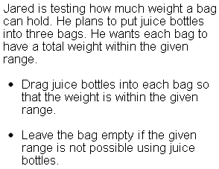
Let’s do a task

Slide 16
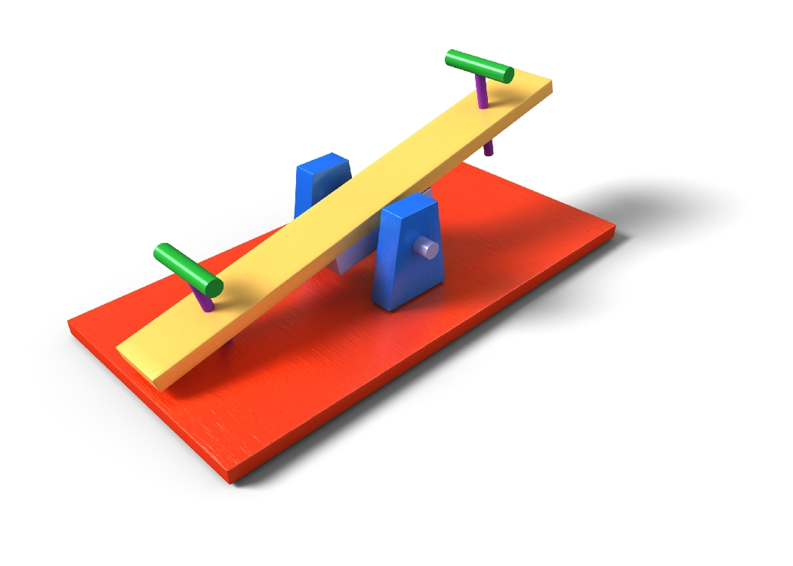
Smarter Balanced Assessment
http://www. Smarter balanced.org
Notes:
Use webpage for highlights of the characteristics of this assessment
Down load examples as PDFs to show from the website – they are too large to paste in here.
Notes from Webinar:
4 Big Ideas assessed: Concepts and Procedures, Problem Solving, Communication and Reasoning, and Modeling and Data Analysis
Adaptive tests and performances

Slide 17
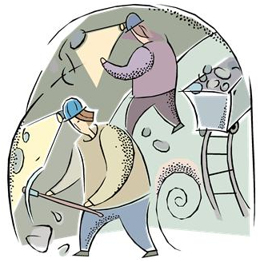
Resources for Rich Tasks & More
plaeaiowacoreleadership.weebly.com

Slide 18
Poll Everywhere Check
To what degree are you able to describe the role of Rich Tasks in the Iowa Core?

Slide 19
K-12 Domains
Grade K
Grade 1
Grade 2
Grade 3
Grade 4
Grade 8
Grade 5
Grade 6
Grade 7
Grade 9-12
Counting & Cardinality
Standards for Mathematical Practice
Number & Operations in Base 10
The Number System
Number &
Quantity
Operations & Algebraic Thinking
Expressions & Equations
Algebra
Number Operations – Fractions
Ratios & Proportional Relationships
Functions
Modeling
Measurement & Data
Statistics & Probability
Geometry
19
19
19
©2011 Cooperative Educational Service Agency (CESA) 7 School Improvement Services Permission is granted to the Iowa State Department of Education for dissemination and use in any whole or part in any form within the state of Iowa region.

Slide 20
Ratios and Proportional Relationships
Notes:
We’ll begin our study of the domains with Ratio & Proportional Reasoning, Expressions & Equations, and Functions as they make a bundle of algebraic thinking and reasoning

Slide 21
Finding Priorities through Critical Areas
1. Highlight the words or phrases in the Critical Area which represent the important mathematics
2. Turn to the standards and highlight the standards which support this Critical Area
(You will do this activity multiple times to learn about each Critical Area, using a different color of highlighting for each one)

Slide 22
An Example
Big Bananas
http://www.youtube.com/watch?v=JktVpDWO7yU
Notes:
Solve this problem
5 miles in 1 hour; it takes 1/5 of an hour for each 1 mile
Identify the understandings and generalizations students should make with this problem
Link to the content standards
Link to the standards for mathematical practice
Does this problem have any of the characteristics of rich tasks we’d want to use with students?

Slide 23
Vertical Connections between Grades
Grade 6 | Grade 7 | Grade 8 Connection to E&E and Fxn

Slide 24
What do you think?
“Proportional Reasoning has been described as the capstone of elementary school arithmetic and the gateway to higher mathematics…” Adding It Up, 2001.
After investigating this domain, what is your response to this statement? Record your thoughts in your journal.
Notes:
JOURNAL:
WHAT IS YOUR RESPONSE TO THIS QUESTION?

Slide 25
Poll Everywhere Check
To what degree do you feel confident with the content of the Ratio and Proportional Relationships domain?

Slide 26
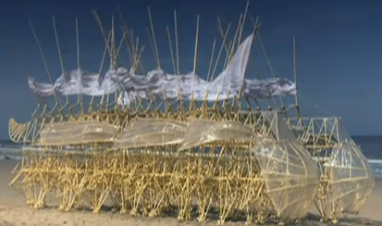
Welcome Back from Lunch!
http://www.youtube.com/watch?v=HSKyHmjyrkA&feature=player_embedded
Notes:
Follow up question:
Does this man exhibit the habits of mind that we’d like to instill in our students? Justify your answer against the mathematical practices.

Slide 27
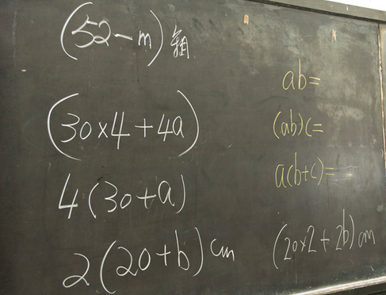
Expressions and Equations

Slide 28
Finding Priorities through Critical Areas
1. Highlight the words or phrases in the standards which represent the important mathematics
2. Turn to the standards and highlight the standards which support this Critical Area
(You will do this activity multiple times to learn about each Critical Area, using a different color of highlighting for each one)

Slide 29
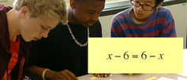
Looking at Rich Tasks
https://www.teachingchannel.org/videos/sorting-classifying-equations-overview?fd=1
https://www.teachingchannel.org/videos/sorting-classifying-equations-discussion
Notes:
Teaching Channel Videos
Sorting and Classifying Equations (8)
https://www.teachingchannel.org/videos/sorting-classifying-equations-overview?fd=1
Sorting and Classifying Equations Discussion (8)
https://www.teachingchannel.org/videos/sorting-classifying-equations-discussion
Think/Pair/Share to practice Simplifying Expressions
https://www.teachingchannel.org/videos/think-pair-share-lesson-idea
4 minutes
7th grade

Slide 30
Vertical Connections between Grades
Grade 6 | Grade 7 | Grade 8

Slide 31
E&E Domain Discussion
Were there instances of many standards funneling into one?
Were there instances of one standard being the launching point for many?
Were there “culminating” standards?
What does this all mean?

Slide 32
Poll Everywhere Check
To what degree do you feel confident with the content of the Expressions and Equations domain?

Slide 33
Investigating the Standards for Mathematical Practice
SMP

Slide 34
Standards for Mathematical Practice
Make sense of problems and persevere in solving them
Reason abstractly and quantitatively
Construct viable arguments & critique the reasoning of others
Model with mathematics
Use appropriate tools strategically
Attend to precision
Look for and make use of structure
Look for and express regularity in repeated reasoning
34
©2011 Cooperative Educational Service Agency (CESA) 7 School Improvement Services Permission is granted to the Iowa State Department of Education for dissemination and use in any whole or part in any form within the state of Iowa region.
Notes:
These practices rest on important “processes and proficiencies” with longstanding importance in mathematics education. The first of these are the NCTM process standards of problem solving, reasoning and proof, communication, representation, and connections. The second are the strands of mathematical proficiency specified in the National Research Council’s report Adding It Up:
adaptive reasoning,
strategic competence,
conceptual understanding (comprehension of mathematical concepts, operations and relations),
procedural fluency (skill in carrying out procedures flexibly, accurately, efficiently and appropriately), and
productive disposition (habitual inclination to see mathematics as sensible, useful, and worthwhile, coupled with a belief in diligence and one’s own efficacy).

Slide 35
Exploring a Standards for Mathematical Practice
Form groups as directed by the facilitator.
Read the paragraph description of the standard for Mathematical Practice assigned to your group.
When you are finished reading, respond to this question in your journal:
In my grade, what will I be planning and doing, and what will the students be doing that will reflect the mathematical practice that I just read?
Notes:
Forming the first groups:
Have participants number off by 4s (1, 2, 3, 4, 1, 2, 3, 4 ….)
The 1’s will be a group, the 2’s will be a group, etc. Assign each group a different Mathematical Practice.
Assign each of the groups a mathematical practice from pages 8 – 10 in the Iowa Core.
JOURNAL:
IN MY GRADE, WHAT WILL I BE PLANNING AND WHAT WILL THE STUDENTS BE DOING THAT WILL REFLECT THE MATHEMATICAL PRACTICE THAT I JUST READ?

Slide 36
When your Group has finished writing
Discuss the “big ideas” you wrote about in your journal.
Create a poster with three sections.
What will students be doing?
What will teachers be planning?
What will teachers be doing?
Notes:
Go over this slide since it involves both discussion and creating a poster.
Provide a poster and markers to each group
Divide the poster into 4 quadrants, Label three like the bullets on the slide, label the fourth Video Notes

Slide 37
Completing your poster
After watching the upcoming video, add to your poster by reflecting on evidence of the mathematical practices.
If there was none, reflect on what the students could have done to show the practice or how the teacher could have promoted the practice.
If it is not appropriate for your mathematical practice to be used in the context of this video, tell why.

Slide 38
Watch this classroom video
http://www.teachingchannel.org/videos/graphing-linear-equations-full-body-style?fd=0
Place your poster on the wall.
Notes:
Here are three different clips that could be used. This powerpoint is using the last one.
Probability of Dependent and Independent Events (6th grade students) http://www.teachingchannel.org/videos/probability-of-dependent-and-independent-events?fd=0
Proportions Trail (7th grade students)
http://www.teachingchannel.org/videos/proportions-trail?fd=1
Graphing Equations Full Body Style (Pre-Algebra MS) http://www.teachingchannel.org/videos/graphing-linear-equations-full-body-style?fd=0
After watching this video, complete the chart reflecting on what evidence of your mathematical practice was seen in the video or, if there was none, reflect on what the students could have done to show the practice or how the teacher could have promoted the practice.
Direct participants to where you want the posters displayed for the gallery walk.

Slide 39
Do an Expert Gallery Walk
Each mathematical practice will have an expert.
Groups will have 1 minute to read the poster.
The expert will give the group’s most important point about the practice and answer any questions from the group.
Notes:
Form groups for the gallery walk. See instructions found in the facilitators guide
Give the expert(s) 1 – 2 minutes to explain and take questions. Signal the groups to rotate to the next poster and again give 1 -2 minutes. Repeat this process until the groups have visited all posters. With fewer than 16 people, use a gallery walk with just one group. Or have each person(s) explain the poster s/he made.

Slide 40
Journaling: Standards for Mathematical Practice
Summarize – Briefly summarize each Standard for Mathematical Practice adding your insights gained
In the Classroom – Write down one idea you have for helping your students acquire these practices.

Slide 41
Intentionality
aforethought
calculated
considered
designed
done on purpose intended
meditated prearranged
meant
willful

Slide 42
Poll Everywhere Check
To what degree do you feel able to describe 4 of the Standards for Mathematical Practice?

Slide 43
In Your Journal
Record the points from your discussion you’d want to remember.
Reflect on how PBITs can help a student develop deep conceptual understanding and skill proficiency at the same time. Write your thoughts in your journal.
Notes:
Close this section with journal writing.

Slide 44
Learning Goals for
“Deeper Investigations” Professional Development
Understand that the structure of the Iowa Core Mathematics are meant to support focus and coherence
Understand that fluency, deep understanding, application and dual intensity support rigor
Understand how to investigate the Iowa Core Mathematics
Notes:
Revisit the goals for today, but also ask the students to look at any personal goals that they wrote in their journals.

Slide 45
Success Criteria
I can describe at least four of the standards for mathematical practice.
I can connect the critical areas for my grade level to the specific standards at my grade level.
I can explain the big ideas of content within the domains at my grade level.
I can describe “mathematical understanding” by explaining how Rich Tasks support it.
I can describe how Iowa Core Mathematics provides a structure to change teaching and learning.
Notes:
Revisit the success criteria for today, but also ask the students to look at any success criteria that they wrote in their journals. At this point you can ask the participants for a signal as to how successful they were (for example, thumbs up, down, or sideways).
JOURNAL:
HOW ARE YOU DOING IN RELATION OF EAECH OF THE SUCCESS CRITERIA:

Slide 46
Poll Everywhere Check
To what degree do you feel able to describe how Iowa Core Mathematics Standards provide a structure to change teaching and learning?

Slide 47
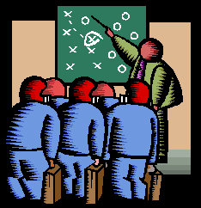
Feedback Survey
http://bit.ly/WdWZff
Notes:
JOURNAL:
3 NEW IDEAS
2 THINGS I WILL USE
1 QUESTION I STILL HAVE

Slide 48
What’s in our future?
Choose one of the following to record in your journal:
My insights on IC will be…
The questions I still have are…
What I still need to learn is….
Notes:
Have participants record a final journaling to one of the prompts:
My insights on IC will be…
The questions I still have are…
What I still need to learn is….

Slide 49
See you soon…
Thanks so much for your participation!
Bring your journal and your copy of the Iowa Core Mathematics next time!
Notes:
Suggest that people use their IC journal between now and next meeting to continue to record questions, comments, and new learning that enhances their learning.

Slide 50
http://www.youtube.com/watch?v=hZyd1s_w6AI&NR=1&feature=endscreen
You will survive!

