Slide 1
Deeper Investigations of the Standards: Iowa Core Mathematics
Grades 6 – 8, Day 2
Iowa Department of Education
In Partnership with
AEA School Improvement
Notes:
1
1
If you want, point out the backing of both DE and AEA in this work for the IC

Slide 2
Welcome…
… from your feedback last time…

Slide 3
Things you never hear about Reading and Writing…..
Notes:
How many times have you heard this phrase – instead aimed at math versus ELA?
“My mom can’t do math and that is why I can’t either.”
Everyone gets a slip of paper with a phrase on it.
Roam the room: If someone said that statement to you, as it is written, why would it be a ridiculous statement; yet when it is said about math, we empathize?
And, instead, make a statement in return about what we can do collectively to stop that.
What double standards are we creating by letting these comments slide for math and not for ELA?
I hate math because…

Slide 4
Iowa Core Mathematics Journal
OMJ
Notes:
Journals will be handed in at the close of class today for everyone.
Download the journal at mathaea8.weebly.com under Deeper Investigations – scroll all the way to the bottom.

Slide 5
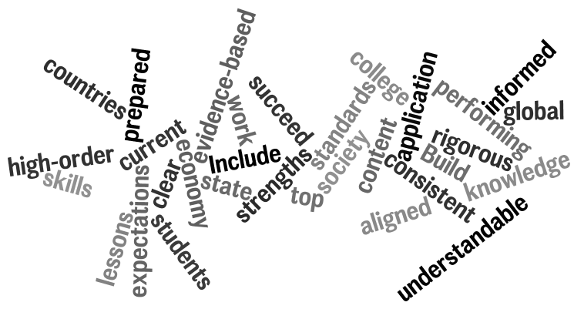
Think About Our Last Session
Notes:
Go to next slide…for activity

Slide 6
What have we done so far?
First Turn, Last Turn
Read your journal entries from the last meeting
One person in the group reads one big idea from his/her journal
In round-robin fashion, everyone can comment on that idea, with the originator having the last turn
Repeat around the table
Notes:
Find your journal from last time….
Although the slide shows the directions, the facilitator needs to go through these extended directions for First Turn, Last Turn:
Groups of 4 to 8. Silently and simultaneously read your journal entries and highlight a few items that have particular meaning for you
Select a person to start each group.
This member shares one of their highlighted items but does not comment on it.
In round-robin fashion, each of the other group members comments about the identified item with no cross-talk
Then the initial person who named the item now shares his or her thinking about the item and therefore, gets the last turn.
Repeat this process for each group member until everyone gets the last word
Stress that there is no cross-talk. Explain that when cross-talk occurs it takes focus off of the speaker, changes the topic, and diminishes the speaker’s influence.

Slide 7
OMJ
Learning Goals for
“Deeper Investigations” Professional Development
Understand that the structures of the Iowa Core Mathematics are meant to support focus and coherence
Understand that fluency, deep understanding, application and dual intensity support rigor
Understand how to investigate the Iowa Core Mathematics
Notes:
These are the goals for this day’s work for the participants here.
Developing a set of learning goals for a course takes what faculty know but don’t always state and puts it into a short list of real concepts that can guide participants and add clarity to teaching and learning.

Slide 8
Success Criteria
OMJ
1. I can describe 6 of the standards for mathematical practice.
2. I can connect the critical areas for my grade level to the specific standards at my grade level.
3. I can explain the big ideas of content within the domains/conceptual categories at my grade level.
4. I can describe “mathematical understanding” by explaining how teacher questioning supports it.
5. I can describe how Iowa Core Mathematics provides a structure to change teaching and learning.
Notes:
Explain that these will appear again at the end of the day. At that time, you will see if you have met them or are part way there.

Slide 9
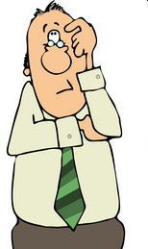
Recall your personal learning goals written in your journal…
Notes:
JOURNAL:
ARE THESE STILL TRUE OR DO THEY NEED TO BE EDITED?
ANY THING ACCOMPLISHED TOWARD THESE GOALS? IF SO, MAKE NOTE!

Slide 10
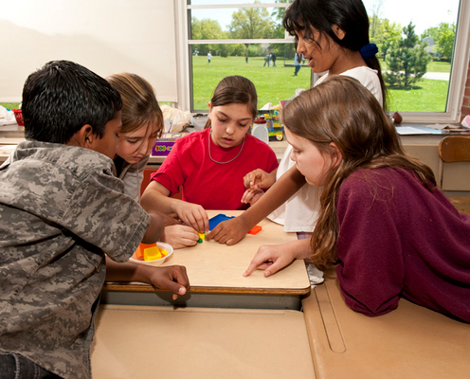
Supporting Rich Mathematical Tasks
Notes:
Finding tasks are part of the work of teachers, but another part of the work is putting them into action.
How does a teacher support the use of rich tasks with their actions?
On the board:
Keep track of all the considerations a teacher must make to teach in this fashion.
-Find a task
-Match to standard(s) or critical area(s)
-Ensure cognitive complexity match
-Be sure the task is ‘rich’
-Figure out where the task belongs within the unit
-Determine which mathematical practices can be taught/used through the task
-Draft teacher questions

Slide 11
Intent of the standards
A curriculum is more than a collection of activities: It must be coherent, focused on important mathematics and well articulated across the grades.
Notes:
A curriculum is more than a collection of activities: It must be coherent, focused on important mathematics and well articulated across the grades.
Discussion: Curriculum coherence requires a focus on interconnections, or big ideas. Big ideas represent fundamental principles; they are the ideas that link the specifics. For example, the notion that benchmark numbers are a way to make sense of other numbers is equally useful for the 6th grader who is trying to place -22 on a number line, the 8th grader who relates pi to the number 3.14…If students differ in a classroom it is usually in terms of specifics or certain skills and not the big idea.
Big ideas can form a framework for thinking about important mathematics and supporting standards driven instruction.
A.SSE.3 for HS
8.F.2 for MS
Have table discussion to determine the intent of the standard: Leave it kind of loose as far as directions – just state, what is the intent of the standard, then, put out the standards insight tool for this one standard and ask: does this KUD express exactly the intent, or would you like to modify the KUD to better reflect your understanding of the intent. Have them spend a few minutes to complete this.
If they need guidance, we could do something like:
Read the standard
2. Identify the Intent – what is the understanding that students need to be able to transfer to future mathematics?
3. Identify the Cognitive Complexity

Slide 12
Dilemma
Notes:
One cannot and should not look at each standard in isolation.
Read Aloud: paragraph about Greecian Urn
By giving the task today, and spending too much time on this one standard, we may give the impression that the Core should be taught this way. So, we need to pause and talk about how it is important to know what each standard says, but in it’s relation to the other standards the cluster and domain it is connected to and the cluster and domains themselves. If we isolate the standards, then we run the risk of isolating and or forgetting the mathematical practices. This then becomes similar to what has been done in the past with NCTM’s process standards.
So, it is important to look at the domain/conceptual category as a whole and understand what the domain/conceptual category is trying to achieve.
Read Bill’s Blog and then Kansas handout: Have them share out their thoughts as they read this with their elbow partner – may want to do !, ?, …

Slide 13
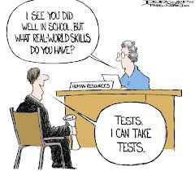
A Task
Notes:
Complete the problem
Give them time to work the problem
Remember the purpose of the problem is to help make that standard we just read come to life and for the standard to start to have meaning.
Table discussion:
To what degree does this task match the intent of the standard we considered before doing the task?
A.SSE.3 for HS
8.F.2 for MS
Are there other standards to which this task is linked?

Slide 14
Is it a Rich Mathematical Task?
Rich mathematical tasks:
Emphasize connections across mathematical content areas, to other disciplines, and especially to the real world
Are accessible yet challenging to all
Can be solved in several ways
Encourage student engagement and communication
Encourage the use of connected multiple representations
Encourage the appropriate use of intellectual, physical, and technological tools
“Not all tasks are created equal, and different tasks will provoke different levels and kinds of student thinking.”
Stein, Smith, Henningsen, & Silver, 2000
Notes:
Pass out the checklist (Yellow Cardstock )
And ask them to determine if it is a rich task? Ask them to rank those checklists almost. Which ones are strong and which are weak?

Slide 15
Where does this fit within a unit?
By teaching through rich mathematical tasks, students develop deep conceptual understanding and skill proficiency.
Why is it important to let students work on a math task without first showing them how to solve it?
http://ifl.lrdc.pitt.edu/ifl/index.php/resources/ask_the_educator/ido_jamar/
Notes:
mathematical tasks cannot be defined as being a task unless they push learning the new content through the problem. So we cannot determine if the task is rich unless we know where the problem falls in the unit
Read this aloud:
A teacher’s goal must be to help students understand mathematics; yet understanding is not something that one can teach directly. No matter how kindly, clearly, patiently, or slowly teachers explain, they cannot MAKE students understand. Understanding takes place in the students’ minds as they connect new information with previously developed ideas, and teaching through problem solving is a powerful way to promote this kind of thinking. Teachers can help and guide their students, but understanding occurs as a by-product of solving problems and reflecting on the thinking that went into those problem solutions. For that reason, this book is all about teaching and learning mathematics through problem solving. By solving problems, students learn to make connections among mathematical ideas.
Page 11 of Teaching Mathematics through Problem Solving, NCTM
A different video choice:
How can we use high-level tasks to promote equity in the mathematics classroom?
http://ifl.lrdc.pitt.edu/ifl/index.php/resources/ask_the_educator/peg_smith

Slide 16
How does the task connect with the Standards for Mathematical Practice?
Notes:
Read Mathematical practices 6 and 7. Review 1 to 4 if necessary.
Discuss at the table how this task connects with the mathematical practices 6 and 7. Then review quickly 1 to 4 and see if any would be appropriate. Be sure each person has a turn discussing.

Slide 17
Standards for Mathematical Practice
Make sense of problems and persevere in solving them
Reason abstractly and quantitatively
Construct viable arguments & critique the reasoning of others
Model with mathematics
Use appropriate tools strategically
Attend to precision
Look for and make use of structure
Look for and express regularity in repeated reasoning
17
17
©2011 Cooperative Educational Service Agency (CESA) 7 School Improvement Services Permission is granted to the Iowa State Department of Education for dissemination and use in any whole or part in any form within the state of Iowa region.

Slide 18
Think-Pair-Share
At your table, half of people will read Mathematical Practice 6, the other people will read Mathematical Practice 7
Those reading the same Practice will discuss the big ideas from the reading
Those reading the same Practice will discuss connections to the problem
The whole table will share their findings

Slide 19
How can you scaffold understanding with questions?
After having engaged in the task, write questions to use Before, During and After students engage in the task.
“In practice, students actual opportunities for learning depend, to a considerable degree, on the kind of discourse that the teacher orchestrates. The nature of the activity and talk in the classroom shapes each students’ opportunities to learn about particular topics as well as to develop her or his abilities to reason and communicate about those topics.”
-Henningsen & Stein, 1997
Notes:
Pass out bookmark resource on questioning. Ask: What do you notice about these questions? (is that right?)
Use the bookmark as a source –
I might provide this question for the HS problem:
If students have difficulty getting started on the task, you might ask, “Just by looking at the four expressions, (a)–(d), without doing any computation, can you
tell me one thing that you know about the flight of the horseshoe?”
Wait on this I think…
In the flipcharts on our homepage, we can look at misconceptions that might need to be addressed in our questioning…
JOURNAL
WHAT POINTS DO YOU WANT TO REMEMBER ABOUT TEACHER QUESTIONING?

Slide 20
An Example…
http://www.pd360.com/index.cfm?ContentId=6114
Notes:
THESE ARE PD 360 VIDEOS – YOU’LL NEED TO LOG IN TO VIEW THESE!!!
On the slide is the MS video:
http://www.pd360.com/index.cfm?ContentId=6114
8th grade linear equations, focusing on 8.EE.8 and MP.4-6
HS Video:
http://www.pd360.com/index.cfm?ContentId=6116
Usefulness of systems of equations, focused on A-REI.7 and MP.2 & 6

Slide 21
What’s the elephant in the room?
What are you wondering about implementation of what we’ve been talking about?
Notes:
How long do I let students struggle before stopping and teaching how to do the problem?
How often do I do problems like this?
What is the difference between using problems and teaching through problem solving?
JOURNAL
WHAT ARE YOU WONDERING ABOUT IMPLEMENTATION OF WHAT WE’VE BEEN TALKING ABOUT? AND, WHAT IS YOUR CURRENT ANSWER?

Slide 22
Poll Everywhere Check
To what degree do you feel able to describe 6 of the Standards for Mathematical Practice?
http://www.polleverywhere.com/multiple_choice_polls/MjAyMTk5ODQxNQ

Slide 23
Poll Everywhere Check
To what degree are you able to describe the role of teacher questioning in building mathematical understanding?
http://www.polleverywhere.com/multiple_choice_polls/MTk3ODM2Mjc2Nw
Notes:
We haven’t used “mathematical understanding” as a vocabulary word so far on these slides.

Slide 24
Your turn
Choose standards which are connected in your curriculum
Determine the intent of the standards
Find task(s)
Judge whether it is a rich task
Link to Standards for Mathematical Practices
Create questions that help to foster deep understanding
Notes:
Question: I am examining algebra conceptual category and you are in eqn’s and exp??
Do you like this as is…

Slide 25
Resources to use
Finding Tasks:
www.nctm.org
http://illustrativemathematics.org/
http://insidemathematics.org/
http://nctm.illuminations.org/
http://www.smarterbalanced.org/
Google the standard notation you are interested in (ex. 8.NS.2)
Notes:
Need to develop how this looks!
Have them do some problems from the flip charts, from the domain/concept catecory that we want them to think about.
Then give them the flip chart and read through it – then they could examine how the problem they did relates to the standard that they are working on.
I don’t think most of these would be considered a rich task, so then they could look for a rich task that addresses more than one standard and gets them to start thinking about how the standards might be “arranged” in their curriculum.
At this point, drop the college and career readiness – we won’t be able to come up with enough for each standard, I am wondering if we do something at the end that pulls them together with one example of this….yikes

Slide 26
K-12 Domains
Grade K
Grade 1
Grade 2
Grade 3
Grade 4
Grade 8
Grade 5
Grade 6
Grade 7
Grade 9-12
Counting & Cardinality
Standards for Mathematical Practice
Number & Operations in Base 10
The Number System
Number &
Quantity
Operations & Algebraic Thinking
Expressions & Equations
Algebra
Number Operations – Fractions
Ratios & Proportional Relationships
Functions
Modeling
Measurement & Data
Statistics & Probability
Geometry
26
26
©2011 Cooperative Educational Service Agency (CESA) 7 School Improvement Services Permission is granted to the Iowa State Department of Education for dissemination and use in any whole or part in any form within the state of Iowa region.

Slide 27
Functions
Input | Add 2 | Output
9 |  | 11
14 |  | 16
53 |  | 55
n |  | n + 2

Slide 28
Finding Priorities through Critical Areas
1. Highlight the words or phrases in the standards which represent the important mathematics
2. Turn to the standards and highlight the standards which support this Critical Area
(You will do this activity multiple times to learn about each Critical Area, using a different color of highlighting for each one)

Slide 29
A Task Example
Comparing Linear
Functions
http://www.insidemathematics.org/index.php/classroom-video-visits/public-lessons-comparing-linear-functions/269-comparing-linear-functions-problem-2-part-a?
Notes:
Comparing Linear Functions
7th and 8th
Introduction
http://www.insidemathematics.org/index.php/classroom-video-visits/public-lessons-comparing-linear-functions/264-comparing-linear-functions-introduction?
To skip watching the intro, give this background: They are analyzing 3 DVD rental plans and which is best in what circumstances
Problem 1
http://www.insidemathematics.org/index.php/classroom-video-visits/public-lessons-comparing-linear-functions/265-comparing-linear-functions-problem-1-part-a?
Problem 2
http://www.insidemathematics.org/index.php/classroom-video-visits/public-lessons-comparing-linear-functions/269-comparing-linear-functions-problem-2-part-a?

Slide 30
Vertical Connections between Grades
Grade 6 , 7 & 8 Connection s to E&E | Grade 8 | HS connections to the functions domain

Slide 31
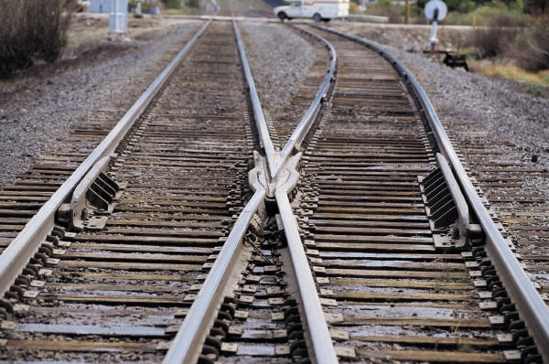
Connections between the Domains
If we think of the domains as being like rails, then we also have to be able to see the ties or “Big Ideas "that bind the rails together.
Notes:
What are the rails you see between Ratio and Proportional Relationships, Expressions and Equations, and the Functions domains?
Go back to the E&E and R&PR work done on day 1, review that and make links to the F domain.
JOURNAL:
IF WE THINK OF THE DOMAINS AS BEING LIKE RAILS, THEN WE ALSO HAVE TO BE ABLE TO SEE THE TIES OR “BIG IDEAS "THAT BIND THE RAILS TOGETHER.
WHAT ARE THE RAILS YOU SEE BETWEEN RATIO AND PROPORTIONAL RELATIONSHIPS, EXPRESSIONS AND EQUATIONS, AND THE FUNCTIONS DOMAINS?

Slide 32
Poll Everywhere Check
To what degree do you feel confident with the content of the Functions domain?
http://www.polleverywhere.com/multiple_choice_polls/NDQ4MDE5NTkx

Slide 33
Algebra I
8th grade looks a lot like Algebra I, so what is Algebra I now?

Slide 34
Iowa Core Mathematics Transition for Algebra I
Traditional Curriculum in Iowa
Iowa Core Curriculum
7th Grade
8th Grade
Algebra 1
Geometry
Algebra 2
7th Grade
8th Grade
Algebra 1
Geometry
Algebra 2
Notes:
This shows the comparison between our traditional Algebra I courses and the newly adopted Iowa Core. In particular, how they relate to Algebra 1 course. You can see that a large portion of what we currently teach in Algebra I will now be taught in the Iowa Core 7th and 8th grade courses. And some of what we currently teach h in Algebra 1 will still be taught in Algebra 1. There are some things we currently teach that is no longer in the Iowa Core and we do not need to teach. That leaves a lot of room in the algebra I course.

Slide 35
Iowa Core Mathematics Transition for Algebra I
New Standards
Algebra 2
Statistics
Probability
Pre-Calculus
Algebra 1
Geometry
7th Grade
8th Grade
Algebra 1
Geometry
Algebra 2
Notes:
Some things we currently teach in Algebra 2 will now be taught in Algebra 1 and a small portion of probability and Statistics will be taught in Algebra I. Then we have some new standards that will finish our Algebra I course.

Slide 36
Iowa Core Algebra 1
New Standards
Statistics/Probability
Traditional Algebra 1
Algebra 2
Algebra 1
Iowa Core Standards
Notes:
So here is the comparison between what we have been teaching and our new Iowa Core Algebra I course.
I have probably talked with your or high school teachers at your district about NCTMs push for Algebra for ALL students.
This was when we were talking mostly about Algebra I when it was Linear Algebra.
Now the bar is very much raised. Now we’re not only talking about algebra concepts past linear, but statistics and probability, functions, and so on.

Slide 37
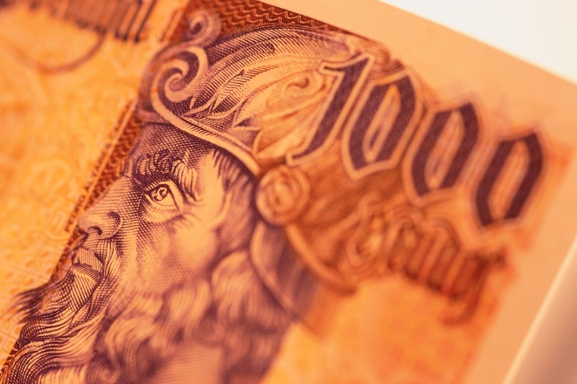
The Number System

Slide 38
Finding Priorities through Critical Areas
1. Highlight the words or phrases in the standards which represent the important mathematics
2. Turn to the standards and highlight the standards which support this Critical Area
(You will do this activity multiple times to learn about each Critical Area, using a different color of highlighting for each one)
38

Slide 39
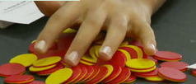
Let’s See a Task
https://www.teachingchannel.org/videos/teaching-subtracting-integers
Zero Pairs
Notes:
Zero Pairs, Manipulatives, and a Real World Example
https://www.teachingchannel.org/videos/teaching-subtracting-integers
Grade 7 Integer Operations
What’s Your Sign: Integer Addition
https://www.teachingchannel.org/videos/adding-integers-lesson-idea
What Fraction of the shape is red?
https://www.teachingchannel.org/videos/teaching-fractions

Slide 40
Vertical Connections between Grades
Grade 6 | Grade 7 | Grade 8
40
40

Slide 41
Journaling
Were there instances of many standards funneling into one? Explain.
Where there instances of one standard being the launching point for many? Explain.
Were there “culminating” standards? What does this mean?

Slide 42
Poll Everywhere Check
To what degree do you feel confident with the content of the Number System domain?
http://www.polleverywhere.com/multiple_choice_polls/LTE0ODQzMDYyOQ

Slide 43
Poll Everywhere Check
To what degree do you feel able to describe how Iowa Core Mathematics Standards provide a structure to change teaching and learning?
http://www.polleverywhere.com/multiple_choice_polls/MjA1NzQ0Nzg0OQ

Slide 44
Learning Goals for
“Deeper Investigations” Professional Development
Understand that the structure of the Iowa Core Mathematics are meant to support focus and coherence
Understand that fluency, deep understanding, application and dual intensity support rigor
Understand how to investigate the Iowa Core Mathematics
Notes:
Revisit the goals for today, but also ask the students to look at any personal goals that they wrote in their journals.

Slide 45
Success Criteria
1. I can describe 6 of the standards for mathematical practice.
2. I can connect the critical areas for my grade level to the specific standards at my grade level.
3. I can explain the big ideas of content within the domains/conceptual categories at my grade level.
4. I can describe “mathematical understanding” by explaining how teacher questioning supports it.
5. I can describe how Iowa Core Mathematics provides a structure to change teaching and learning.
Notes:
Revisit the success criteria for today, but also ask the students to look at any success criteria that they wrote in their journals. At this point you can ask the participants for a signal as to how successful they were (for example, thumbs up, down, or sideways).

Slide 46
Give us feedback about your learning
3 Things you learned today
2 Things you will use
1 Question you still have

Slide 47
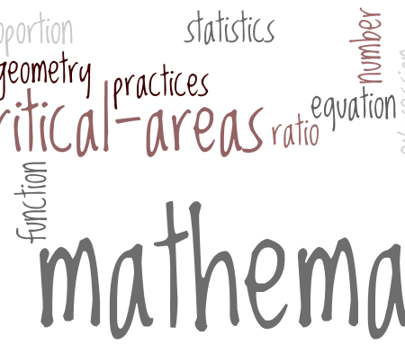
What are the actions I need to take to improve my implementation of the Iowa Core?
Are there things you need to learn?
Are there things you need to ask for others to be a part of?
Are there resources you need to find?

Slide 48
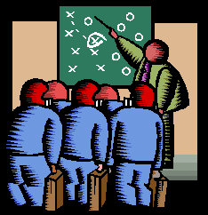
Feedback Survey
http://survey.aea.k12.ia.us/f/94656/ac2a/

Slide 49
See you soon…
Thanks so much for your participation!
Bring your journal and your copy of the Iowa Core Mathematics next time!
Notes:
Suggest that people use their IC journal between now and next meeting to continue to record questions, comments, and new learning that enhances their learning.

