Slide 1
Deeper Investigations of the Standards: Iowa Core Mathematics
Grades 6 – 8, Day 3
Iowa Department of Education
In Partnership with
AEA School Improvement
Notes:
1
1
Note how long it has been since the last meeting of this group.
If teachers are not with the same group of people, be sure there is an introduction of people at each table.
Even if they are the same group, consider a quick minute for this.

Slide 2
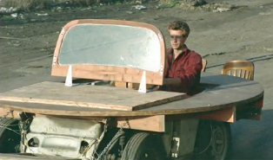
Math & Art Integration
http://www.youtube.com/watch?v=D2HF-1xjpP8&feature=em-hot-vrecs

Slide 3
Welcome…
… from your feedback on last time…
Notes:
From day 2 feedback, here were a few questions:
Are there going to be textbooks or workbooks for this? Yes, likely there will be. They’ll need time to be developed and you’ll need to get to the right point on your school’s adoption cycle. We’re talking about what we’ll do now and how we’ll do it in preparation for that. For HS specifically, the 2012 editions are aligning content to the Appendix A set up.
Can we see videos of this?
The Teaching Channel
The Hunt Institute
Dan Meyer’s Blog
Achieve

Slide 4
Where have we been?
Partners Report
Review your journal entries from Days 1 and 2, identify the most important point for you so far plus the classroom impact of that point
Find a partner not at your table
Exchange most important points and its impact
Partners will share one another’s information
Notes:
Read your journal entries from day 2 of deeper.
4

Slide 5
Learning Goals for
“Deeper Investigations” Professional Development
Understand that the structures of the Iowa Core Mathematics are meant to support focus and coherence
Understand that fluency, deep understanding, application and dual intensity support rigor
Understand how to investigate the Iowa Core Mathematics
Notes:
Reminder of this workshop’s learning goals.

Slide 6
Success Criteria
I can describe all 8 of the standards for mathematical practice.
I can explain the big ideas of content within the domains or conceptual categories.
I can describe how Iowa Core Mathematics provides a structure to change teaching and learning.
Notes:
Reminder of the success criteria. Ask participant’s if they recall how far they were to achieving success in these learning goals.

Slide 7
K-8 Domains/HS Conceptual Categories
Grade K
Grade 1
Grade 2
Grade 3
Grade 4
Grade 8
Grade 5
Grade 6
Grade 7
Grade 9-12
Counting & Cardinality
Standards for Mathematical Practice
Number & Operations in Base 10
The Number System
Number &
Quantity
Operations & Algebraic Thinking
Expressions & Equations
Algebra
Number Operations – Fractions
Ratios & Proportional Relationships
Functions
Modeling
Measurement & Data
Statistics & Probability
Geometry
7
7
7
©2011 Cooperative Educational Service Agency (CESA) 7 School Improvement Services Permission is granted to the Iowa State Department of Education for dissemination and use in any whole or part in any form within the state of Iowa region.

Slide 8
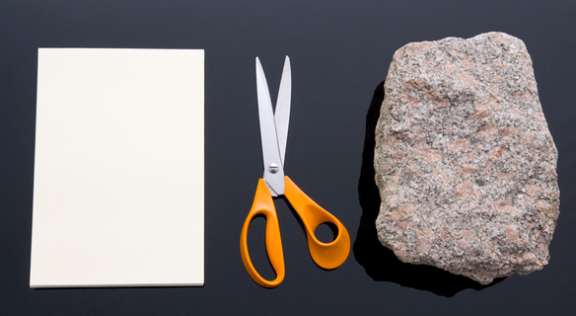
Statistics and Probability
Notes:
This activity has several phases in which to guide teachers through discovering statistics and probability standards in the IC and their levels of familiarity with them. The facilitator will have to be explicit in directions.

Slide 9
Finding Priorities through Critical Areas
1. Highlight the words or phrases in the standards which represent the important mathematics
2. Turn to the standards and highlight the standards which support this Critical Area
(You will do this activity multiple times to learn about each Critical Area, using a different color of highlighting for each one)

Slide 10
Vertical Connections between Grades
Grade 6 | Grade 7 | Grade 8

Slide 11
Discuss in your group….
What is in the IC that is the same as what you have been teaching?
What is new?
What concepts are unfamiliar to you?
Notes:
Allow for plenty of discussion time from their findings in the middle column as time permits.

Slide 12
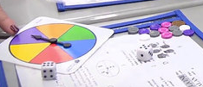
Let’s see a task example
https://www.teachingchannel.org/videos/teaching-dependent-and-independent-events
Probability of Dependent and Independent Events
Notes:
Probability of Dependent and Independent Events
https://www.teachingchannel.org/videos/teaching-dependent-and-independent-events
5 minutes
This is in a 6th grade class but it is a 7th grade CCSS standard!

Slide 13
Poll Everywhere Check
To what degree do you feel confident with the content of the Statistics and Probability domain?
http://www.polleverywhere.com/multiple_choice_polls/LTQ5ODc4ODU2NA

Slide 14
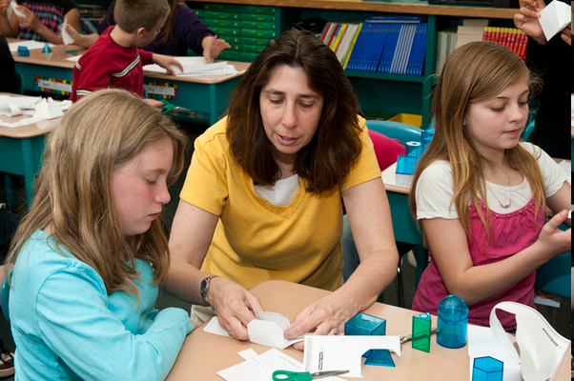
Geometry

Slide 15
Exploring the Geometry Domain
Read--
“Understanding the van Hiele Levels”
Reflect in your journal
What van Hiele level best describes you? Your students? Explain.

Slide 16
Van Hiele Levels
Visualization
Analysis
Informal Deduction
Deduction
Rigor
As you finish your reflection, share what you wrote with your group.

Slide 17
Characteristics of the Levels
The levels are sequential
The levels are not age-dependent
Geometric experience is the greatest single factor influencing advancement through the levels.
When instruction or language is at a level higher than that of the student, there will be a lack of communication.

Slide 18
Searching through the Geometry Standards
Read each standard and select the van Hiele level the standard seems to fit
Using the provided standard strips, decide the order in which these standards should occur from K – HS
Check your order by using the Iowa Core

Slide 19
Finding Priorities through Critical Areas
1. Highlight the words or phrases in the standards which represent the important mathematics
2. Turn to the standards and highlight the standards which support this Critical Area
(You will do this activity multiple times to learn about each Critical Area, using a different color of highlighting for each one)

Slide 20
Vertical Connections between Grades
Grade 6 | Grade 7 | Grade 8
20

Slide 21
Let’s see a task example
Discover the Surface Area of a Cylinder
https://www.teachingchannel.org/videos/surface-area-lesson
Notes:
Discover the Surface Area of a Cylindar
https://www.teachingchannel.org/videos/surface-area-lesson
WATCH THE FIRST 5 MINUTES ONLY!!!!!!!
A Table for 22
https://www.teachingchannel.org/videos/real-world-geometry-lesson
6th Grade

Slide 22
Poll Everywhere Check
To what degree do you feel confident with the content of the Geometry domain?
http://www.polleverywhere.com/multiple_choice_polls/LTIxMzcwMDAzODg

Slide 23
Journaling
Now that we’ve studied each of the content domains, let’s consider a few questions:
There are standards which may fit into more than one critical area and those which don’t fit into any.
Why does this happen?
What does it mean for instruction?
How do the critical areas help me to set priorities for my grade level?

Slide 24
Poll Everywhere Check
To what degree do you feel able to describe the critical areas for your grade level?
http://www.polleverywhere.com/multiple_choice_polls/LTQxMjQ4NTIzOQ

Slide 25
Let’s do a task…
In 6th grade we discovered the formula for finding the Volume of a rectangular solid.
In 7th grade we used that
to find the volumes of
more complex shapes.
http://illuminations.nctm.org/ActivityDetail.aspx?ID=6
Notes:
Imagine you are an 8th grade student about to start into this study of volume
All you know is the background information we have done in grades 6th and 7th which has been all about rectangular solids.
This would have included the use of physical tools like the Illuminations Activity

Slide 26
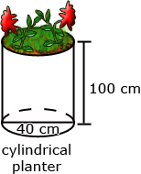
Let’s do a task…
James wanted to plant pansies in his new planter. He wondered how much potting soil he should buy to fill it. Use the measurements in the diagram below to determine the planter’s volume.
Notes:
What questions could we ask to help students bridge the gap from rectangular solids to cylindrical solids?
Questions for students:
What do you know about volume?
What do you know about the formula for volume of a rectangular solid?
What shape do you see on the screen?
What shape is the base?
How does the formula for volume of a rectangular solid help you to determine the volume of a cylinder?
What solution strategies might students have at this starting point?

Slide 27
Big Idea: the volume of any 3-D shape is dependent on the area of its base, height of the shape, and the number of parallel bases (layers) that the shape has
Notes:
How do we help kids generate the formulas for volume without telling them?
The volume of the rectangular solid is l x w x h or B x h
The volume of a cylinder is pi x r² x h or B x h
The volume of a cone is 1/3(pi x r² x h) or 1/3(B x h)
The volume of a pyramid (with a rectangular base) is 1/3(l x w x h) or 1/3(B x h)
The volume of a hemisphere is 2/3(pi x r³)
The volume of a sphere is 4/3(pi x r³)
The volume of a sphere is 2/3 (pi x r² x 2r)
Think of it like this: the volume of a sphere is 2/3 of a cylinder 2/3 (Pi x r² x h) in the case of a sphere, the h is 2 x r
This of it like this: the volume of a sphere is 2 times the volume of a cone 2 [1/3 (pi x r² x h)]
1/3(pi x r² x h) = 4/3(pi x r³)
Discussion around “what is a base in prisms?” and “what is the height?”
Think of the traditional barn shape – look at the roof – where are the bases and what is the height?
The standard is 8.G.9
What is the advantage of having kids generate the formulas?
This is where we move from teaching the topic of volume formulas to the concept of volume and the connections between the shapes
This type of work also supports the standards for mathematical practice: 1, 3, 7

Slide 28
The impact of discovery
Connecting volume formulas with proportions
http://www.youtube.com/watch?v=NAcTBJ1boD4
Notes:
Watch this video to see the connections between the volume of rectangular solid, cylinder and cone.
This is one way you could scaffold the work for kids to generate one volume formula from the previous one.
Also note the connection between the Ratio and Proportional Relationship and Geometry domains!
We are focusing on the Geometry standard 8.G.9
This also links with 7.G.6.
And with 7.PR.2.c.

Slide 29
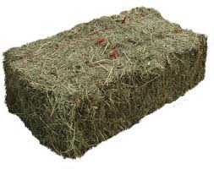
Rich Task
32 Feet
Here is a corn crib, how many hay bales will fill it?
24 feet
18 inches
36 inches
18 inches
50 feet
Notes:
What do you need to know?
For the corn crib
Circumference 50 feet
Heights of cylinder 24 feet, height to peek 32 feet
For the bale
Length 36 inches
Width 18 inches
Height 19 inches
794 bales is the maximum capacity.
Is the farmer really going to be able to fit that number of bales?
What are the sources of error in our calculation?

Slide 30
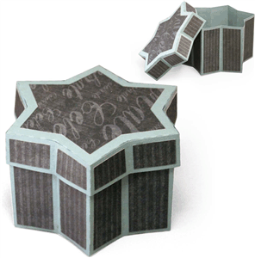
Performance Task
You are starting a business for this Hanukkah season. You are making kits for girls to make necklaces. You have six sided star beads and want to choose a container which is also a six sided star, however, you need to determine the volume you want for the container before ordering them to be made.
If you have x cubic feet of beads, how many containers would you be able to fill?

Slide 31
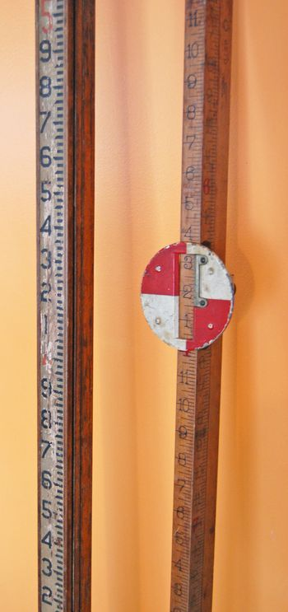
Extension
Notes:
The focus with this problem is not generating a correct, accurate answer, but instead engaging in reasonable solution strategies and the mathematical practices.
This is the adult type of application of volume formulas.

Slide 32
An approach to concept based teaching
Big Idea
Performance Task
Notes:
After our last session, we felt the conversation around teaching through problem solving and how that can be accomplished needed to be explored by us.
This is our attempt to begin that process.
What can fit into those boxes? Lessons, problems, videos, discussions, public negotiation, …

Slide 33
MP.8 Look for and Express Regularity in Repeated Reasoning
Read the description of this Standard for Mathematical Practice on Page 10 of the standards.
Mathematically proficient students…
notice repeating calculations and look for efficient methods/representations to solve a problem.
evaluate the reasonableness of their results throughout the problem solving process.
What does this imply for you?
Notes:
Repeated calculations appear in this work through the repeated use of B x h.
The de-contextualizing of that portion of the formulas repeats throughout all of the shapes.
Use think and pair of think/pair/share

Slide 34
MP.8 Look for and Express Regularity in Repeated Reasoning
What does this mean for task and teacher?

Slide 35
MP.5 Use appropriate tools strategically
Read the description of this Standard for Mathematical Practice on Page 9 of the standards.
Mathematically proficient students…
consider the available tools when solving a problem (i.e. calculator, protractor, ruler, manipulatives, software).
make sound decisions about tool selection.
detect possible errors when using tools by strategically using estimation and other mathematical knowledge.
What does this imply for you?

Slide 36
MP.5 Use appropriate tools strategically
What does this mean for task and teacher?
Notes:
Use think and pair of think/pair/share . Then, share out for both mathematical practice 8 and 5.

Slide 37
Let’s See an Example:
SMP 5
http://www.youtube.com/watch?v=Skocybk5zUg
SMP 8 http://www.youtube.com/watch?v=nDdYEBPZJSI
Notes:
http://www.insidemathematics.org/index.php/standard-6
This video is meant to highlight #5
http://www.youtube.com/watch?v=Skocybk5zUg
This video is meant to highlight #6
http://www.youtube.com/watch?v=LlTEv64v7vw
Do you think the textbook is distracting to the Standard??
This video is meant to highlight #7
http://www.youtube.com/watch?v=iZTu_hSjF0g
This video is meant to highlight #8
http://www.youtube.com/watch?v=nDdYEBPZJSI

Slide 38
Poll Everywhere Checks
I can describe all 8 of the standards for mathematical practice.
http://www.polleverywhere.com/multiple_choice_polls/LTIxMjQ2NzYwNTQ

Slide 39
Post Assessment
http://survey.aea.k12.ia.us/f/94549/bba4/
Notes:
Post Assessment Survey Link: http://survey.aea.k12.ia.us/f/94549/bba4/
Post Assessment Report Link: http://survey.aea.k12.ia.us/report/94549/100310/43d80dbb?afterVoting=4a43381bfccd

Slide 40
Transitioning to the Iowa Core
The Iowa Core for Mathematics requires a change in when we teach content… so what will we do about that?

Slide 41
Start a grade level transition plan
Middle School
Have your standards book next to the table of contents of your text
6th grade: pages 41 & 42
7th grade: pages 47 & 48
8th grade: pages 53 & 54
High School
Have your copy of Appendix A next to the table of contents of your text
Algebra I: page 16
Geometry: page 28
Algebra II: page 37
Notes:
This work is to be done in class specific /grade level groups.
Teachers will need their text books to do this.
We are starting with the Critical Areas

Slide 42
Start a grade level transition plan
Compare the clusters within the domains to the table of contents of your text.
Mark in the standards:
+When there are clusters which you have not taught in the past at this grade/course
Mark in the table of contents in your text:
+When the content is there, but you usually don’t use it
-When the content is there, but you need to stop using it
When the content is there, and you keep using it

Slide 43
Start a group transition plan
Using the chart papers prepared for your district, create a 2 year plan which moves you closer to implementing the content of the Iowa Core.
Based on your critical areas, each person needs to make a case for which cluster(s) they need to give up, and which one(s) they will take on, keeping in mind that it all can’t be done in 180 days.
Remember, this is an agreement between the giver and the taker.
How will you communicate these decisions?
Notes:
This portion of the planning is done as a district group.
At the end of the time allotment, have teams write their communication plan – who must be told, when, what exactly needs to be told?
While waiting for all district teachers to complete their personal transition plan, work on these Anchor Activities: [write this on the white board]
Watch videos from the handout.
Locate problems you may use at Illustrative Math or other sites on the Weebly.
Sketch out concept based unit plans from Big Idea to Performance Task.

Slide 44
Poll Everywhere Check
To what degree do you feel able to describe how Iowa Core Mathematics Standards provide a structure to change teaching and learning?
http://www.polleverywhere.com/multiple_choice_polls/MTg0MTgzMTIyNw

Slide 45
Success Criteria
I can describe all 8 of the standards for mathematical practice.
I can explain the big ideas of content within the domains or conceptual categories.
I can describe how Iowa Core Mathematics provides a structure to change teaching and learning.
Notes:
Now, how would you rate your success?

Slide 46
Create a three column chart in your journal. Label the columns… “What,” “So What?” and “Now What?”
Reread your journal entries
Identify: What the big ideas are
Interpret: So What is the meaning?
Capture the Now What for predictions and implications for further study and work
Notes:
Directions for Here’s What, So What, Now What:
Create a three column table
Explain the purpose of each column-
Here’s What for specific information
So What for an interpretation or meaning of the information
Now What for a prediction, an implication, or a question for further study
Complete the table individually, then process the Now What as a small group.
Implications and meanings will overlap between people.
Examples of each column:
What In grade 8 Geometry, there is heavy use of transformations to do informal proofs
So What I have not taught transformations to this depth before, it means I’ll have to change what I teach in this area
Now What I have to talk with the other teachers who will be teaching transformations before me to determine what students will be able to do when they come to me
I have to find resources for this
I have to plan with the other 8th grade teachers to be sure we all do this
46

Slide 47
Give us feedback about your learning
http://survey.aea.k12.ia.us/f/94708/1154/
Notes:
Feedback form for Session 4 Survey Link: http://survey.aea.k12.ia.us/f/94708/1154/
Feedback form for Session 4 Report Link: http://survey.aea.k12.ia.us/report/94708/100380/a79e5975?afterVoting=3a7d4aa55599

Slide 48
Thank you for all your work

