Slide 1



Investigating the Standards:
Iowa Core Mathematics
Grades 6 - 8
Iowa Department of Education
In Partnership with
AEA School Improvement
©2011 Cooperative Educational Service Agency (CESA) 7 School Improvement Services
Permission is granted to the Iowa State Department of Education for dissemination and use in any whole or part in any form within the state of Iowa region.
Notes:
1
1
If want, point out the backing of both DE and AEA in this work for the IC

Slide 2
Welcome!
A few logistics …
©2011 Cooperative Educational Service Agency (CESA) 7 School Improvement Services
Permission is granted to the Iowa State Department of Education for dissemination and use in any whole or part in any form within the state of Iowa region.

Slide 3
Ground Rules for Today
Information-Giving
Group Work & Recording
Attentive listening
Open mindset to receive new ideas and information
Note-taking
Open mindset
Professional conversations
Careful note-taking (for taking back)
Deep thinking
Record questions – to be addressed later
3
©2011 Cooperative Educational Service Agency (CESA) 7 School Improvement Services
Permission is granted to the Iowa State Department of Education for dissemination and use in any whole or part in any form within the state of Iowa region.
Notes:
We have 2 types of work today. You will be receiving information, but also working as small groups to investigate the IC Math document. In order to do all this work, we have some ground rules.

Slide 4
The Message
Today is the initial investigation to be followed by deeper investigation.
This is an extended process toward full implementation.
It cannot/should not be rushed – a marathon, not a race.
Our focus is to learn HOW to investigate these standards.
We won’t be aligning today – because alignment cannot be done effectively without careful investigation.
4
©2011 Cooperative Educational Service Agency (CESA) 7 School Improvement Services
Permission is granted to the Iowa State Department of Education for dissemination and use in any whole or part in any form within the state of Iowa region.
Notes:
Read through these for the audience even though slide is there. Field any questions about these five statements.

Slide 5
Learning Goals:
Understand that the structure of the Iowa Core Mathematics are meant to support focus and coherence
Understand that fluency, deep understanding, application and dual intensity support rigor
Understand how to investigate the Iowa Core Mathematics
Notes:
Developing a set of learning goals for a course takes what faculty know but don’t always state and puts it into a short list of real concepts that can guide participants and add clarity to teaching and learning.

Slide 6
Success Criteria:
I can explain at least two of the standards for mathematical practice.
I can describe the critical areas for my grade level.
I can locate my grade level content standards and explain the differences among standards, clusters, and domains.
I can describe “mathematical understanding” by giving an example and non-example.
I can describe how Iowa Core Mathematics provides a structure to change teaching and learning.
Notes:
“I Can” statements should reflect what the learner will be able to do at the end of the learning experience

Slide 7

Notes:
These six outcomes are the framework of the implementation plan

Slide 8
Leadership-System Capacity
Community-Support Implementation
Schools-Continuous Improvement
Alignment of Content, Instruction and Assessment
Professional Development to improve Content, Instruction, and Assessment
Instruction: Effective Practices in Instruction/Assessment Student Engagement
Iowa Core Outcomes

Slide 9
6 Shifts to Iowa Core Mathematics
Rigor
Fluency
Deep Understanding
Applications
Dual Intensity
Focus
Coherence
Notes:
Focus
Narrow the content, spend more time on fewer topics, get direction from Critical Areas at each grade level/Iowa Core standards
Focus instructional time on priority concepts
Give the students the gift of time (allows time for students to engage in mathematical practices)
Coherence
Students are able to connect from previous years and carry forward
Use learning progressions as they are developed to help clarify coherence
Make tighter vertical connections
Rigor
Fluency
Fluency inside of problem situations
Students as they problem solve are able to call upon skills that move them forward in solving the problem without having to revisit how to do the skill
**Caution: Do not take this shift out of context and assume it is meaning an isolated procedural fluency, it is meant to be done in context of all of the 6 shifts together. For example, practicing by completing 50 problems of the same type will build a skill in isolation but not build deep understanding or address dual intensity**
Deep Understanding
Deep conceptual understanding of priority concepts, show mastery at a deep level
Students are the ones to articulate mathematical reasoning
Create opportunities for students to understand ideas from a variety of access points
Application
Apply math in other content areas and situations
Engage in real world experiences
Problems need to be problematic (too much info, incomplete info, decision making,...)
Rich tasks are required here
Dual Intensity
Math work should result in both procedural fluencies and conceptual understanding
Balance of fluency and application work
ELA shifts:
Shift 1 Balancing Informational & Literary Text
Students read a true balance of informational and literary texts.
50:50 at elementary; 60:40 at middle school; 70:30 at high school
Shift 2 Knowledge in the Disciplines
Students build knowledge about the world (domains/ content areas) through TEXT rather than the teacher or activities
Shift 3 Staircase of Complexity
Students read the central, grade appropriate text around which instruction is centered. Teachers are patient, create more time and space and support in the curriculum for close reading.
Shift 4 Text-based Answers
Students engage in rich and rigorous evidence based conversations about text.
Shift 5 Writing from Sources
Writing emphasizes use of evidence from sources to inform or make an argument.
Shift 6 Academic Vocabulary
Students constantly build the transferable vocabulary they need to access grade level complex texts. This can be done effectively by spiraling like content in increasingly complex texts.

Slide 10
Journey to IC Mathematics
The Iowa State Board of Education adopted Common Core State Standards (CCSS) for English language arts and mathematics on July 29, 2010.
CCSS in English language arts and mathematics replaced the literacy and mathematics sections of the Iowa Core.
Additional Iowa items were adopted by the State Board on November 17, 2010.
Notes:
Ten standards were added to the CCSS when it was adopted to be the IC. Two of the standards are in second grade (labeled IA1 and IA2) and eight are found in the High School area. A paragraph was added to the seventh of the “Standards for Mathematical Practice” (which you will see in a few minutes).
A way to distinguish this document from the previous Iowa Core, is to refer to it as the “2010 Version.”

Slide 11
Why are common standards good for teachers?
IC Mathematics provides student learning standards for every grade level.
IC Mathematics ensures a common language for educators.
Students will be assessed based on IC Mathematics.
©2011 Cooperative Educational Service Agency (CESA) 7 School Improvement Services
Permission is granted to the Iowa State Department of Education for dissemination and use in any whole or part in any form within the state of Iowa region.
Notes:
“English Language Arts and Mathematics CCSS are just the beginning. . .more subject area standards are being developed”

Slide 12
Why are common standards good for students?
Student Ownership. Clearer standards will help students understand what is expected of them and allow for more self-directed learning.
Consistent. Expectations will be consistent for all students and not dependent on zip code.
Mobility. It will help students with transitions between states.
College & Career Focus. It will help prepare students with the knowledge and skills they need to succeed in college and careers.
©2011 Cooperative Educational Service Agency (CESA) 7 School Improvement Services
Permission is granted to the Iowa State Department of Education for dissemination and use in any whole or part in any form within the state of Iowa region.
Notes:
Student zip code reference means that whether students are across the country, across the state, or across a large city, the standards and expectations for students are the same.

Slide 13
Investigating the
Iowa Core Mathematics
Grades 6 - 8
©2011 Cooperative Educational Service Agency (CESA) 7 School Improvement Services
Permission is granted to the Iowa State Department of Education for dissemination and use in any whole or part in any form within the state of Iowa region.
Notes:
As AEA consultants(math), this work would go much faster than for the LEA faculty who are taking part in this PD. Be aware that times are a “best guess”.

Slide 14

1
Standards for Mathematical Practice
“The Standards for Mathematical Practice describe varieties of expertise that mathematics educators at all levels should seek to develop in their students.”
IC Mathematics page 8
©2011 Cooperative Educational Service Agency (CESA) 7 School Improvement Services
Permission is granted to the Iowa State Department of Education for dissemination and use in any whole or part in any form within the state of Iowa region.
Notes:
This slide begins the introduction of Activity 1 (note the IC 1 symbol in the upper right-hand corner.)

Slide 15
Standards for Mathematical Practice
1
Make sense of problems and persevere in solving them
Reason abstractly and quantitatively
Construct viable arguments & critique the reasoning of others
Model with mathematics
Use appropriate tools strategically
Attend to precision
Look for and make use of structure
Look for and express regularity in repeated reasoning
Refer to Pages 8-10 in IC Mathematics
©2011 Cooperative Educational Service Agency (CESA) 7 School Improvement Services
Permission is granted to the Iowa State Department of Education for dissemination and use in any whole or part in any form within the state of Iowa region.

Slide 16
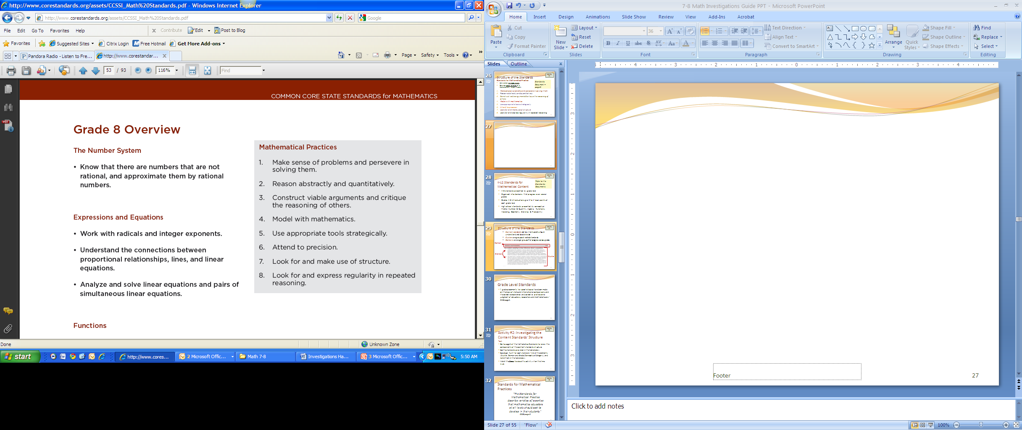
1
The Practices are listed at the beginning of each grade level.
Standards for Mathematical Practice are also provided in detail on pages 8-10.
©2011 Cooperative Educational Service Agency (CESA) 7 School Improvement Services
Permission is granted to the Iowa State Department of Education for dissemination and use in any whole or part in any form within the state of Iowa region.
Notes:
This slide is showing where the Mathematical Practices are found at each grade level. (Overview slide)

Slide 17
Activity 1:
Investigating the Standards of Mathematical Practice
At your table choose two mathematical practices
Read and discuss them
Read the problem at the right and solve
After completing the sample problem, think about what evidence would show a student is demonstrating the mathematical practices.
In the chart, describe characteristics in students’ thinking and actions you might observe for each practice you chose.
©2011 Cooperative Educational Service Agency (CESA) 7 School Improvement Services
Permission is granted to the Iowa State Department of Education for dissemination and use in any whole or part in any form within the state of Iowa region.
Notes:
Refer participants to Activity 1.
You may want to assign each group two different standards to explore and inform them that they will share their knowledge of those standards with other groups at the end of the activity.
Refer groups to pages 8-10 of the IC for complete descriptions of the Standards for Mathematical Practice.
Encourage groups to discuss the solution to the problem.
A suggestion for participants that finish early is to read the other practices.
Since this activity ends with a “Roam the Room” sharing, the facilitator will have to signal beginning, changing, and end times.
The facilitator may want to tell the participants that they will see and discuss the math problem they solved in another activity.

Slide 18
Success Criteria Check:
Poll Everywhere
To what degree do you feel able to explain at least 2 of the standards of mathematical practice?
http://www.polleverywhere.com/multiple_choice_polls/LTExNTg0MDExMDE

Slide 19
2
MORE FOCUSED:
Increased Clarity and Specificity
“It is important to recognize that “fewer standards” are no substitute for focused standards. Achieving “fewer standards” would be easy to do by resorting to broad, general statements. Instead, these Standards aim for clarity and specificity.”
IC Mathematics page 4.
©2011 Cooperative Educational Service Agency (CESA) 7 School Improvement Services
Permission is granted to the Iowa State Department of Education for dissemination and use in any whole or part in any form within the state of Iowa region.
Notes:
This slide begins the introduction of Activity 2 (note the IC 2 symbol in the upper right-hand corner.)

Slide 20
Critical Area Narratives
2
Important descriptions at the beginning of each grade level
Provide the intent of the mathematics at each grade
Provide 3-4 critical areas for the grade level
Provide a sense of …
  the sophistication for mathematical understanding at the grade level
  the learning progressions for the grade
  extensions from prior standards
  what’s important at the grade level
©2011 Cooperative Educational Service Agency (CESA) 7 School Improvement Services
Permission is granted to the Iowa State Department of Education for dissemination and use in any whole or part in any form within the state of Iowa region.
Notes:
The IC includes Critical Area Narratives for each grade level. This slide describes the purpose of those narratives.

Slide 21

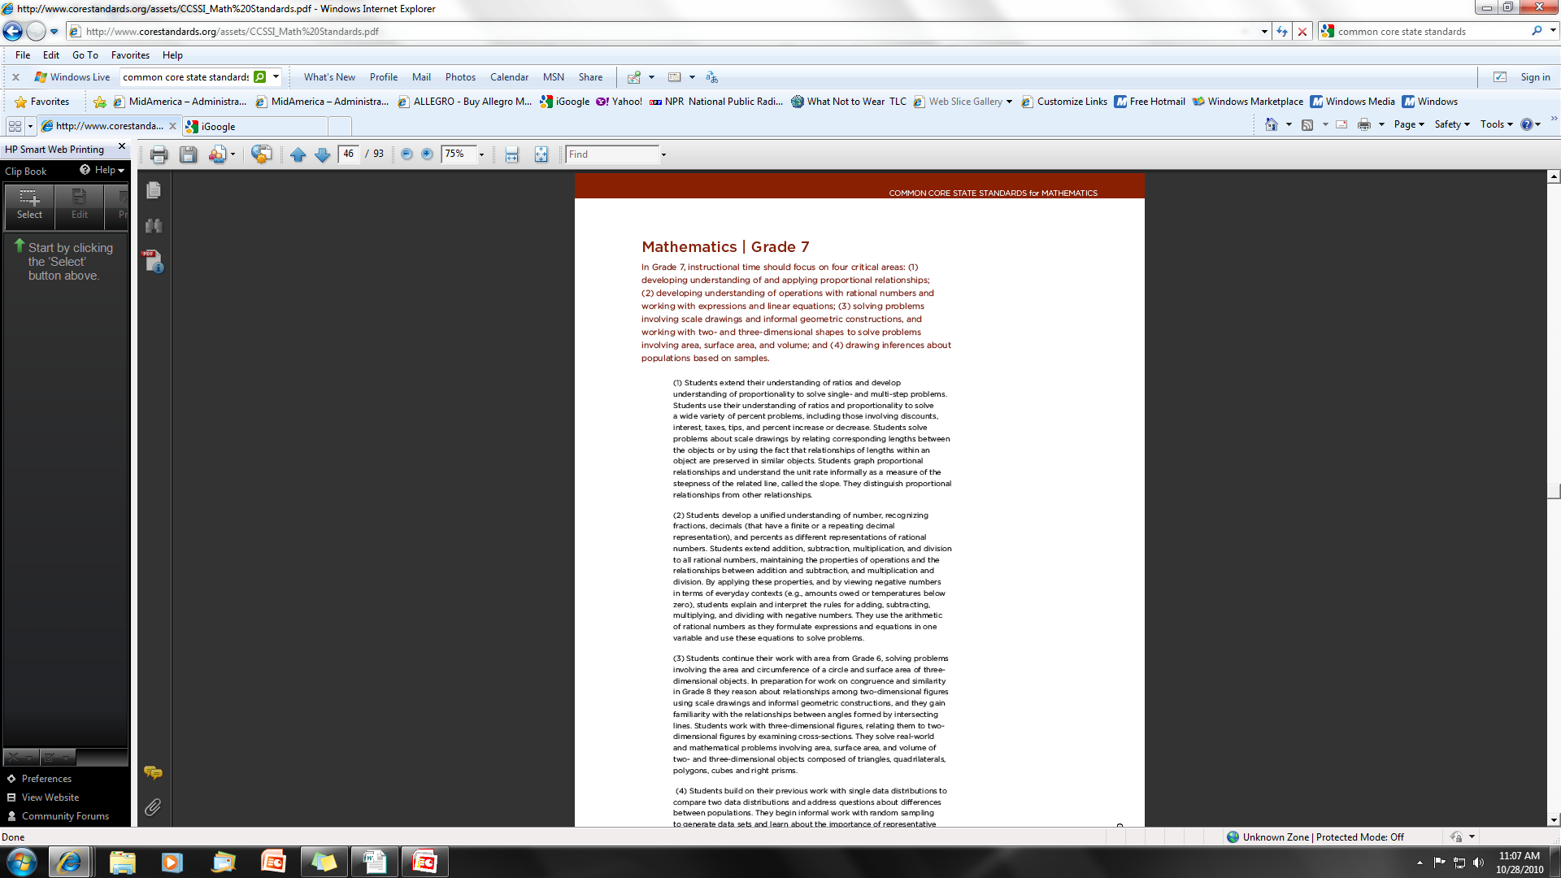
Grade Level Critical Areas
2
Grade 6 Narrative,
IC Mathematics p. 41
Grade 7 Narrative,
IC Mathematics p. 47
Grade 8 Narrative,
IC Mathematics p.53
©2011 Cooperative Educational Service Agency (CESA) 7 School Improvement Services
Permission is granted to the Iowa State Department of Education for dissemination and use in any whole or part in any form within the state of Iowa region.
Notes:
Encourage participants to locate the page in the IC that describes the critical areas for their grade level.

Slide 22
Activity 2:
Investigating Grade Level
Critical Areas
Note the narrative of the critical areas for your grade level in the first paragraph of the IC.
Divide the critical areas among table partners and read the descriptions.
Use the organizers to note what you discover and think about the critical areas.
Discuss your thinking with your table partners about all of the critical areas.
©2011 Cooperative Educational Service Agency (CESA) 7 School Improvement Services
Permission is granted to the Iowa State Department of Education for dissemination and use in any whole or part in any form within the state of Iowa region.
Notes:
Refer participants to Activity 2.
For the discussion bullet, the facilitator may want to add a question prompt “what is the same and what is different from what you now do at your grade level?”

Slide 23
Success Criteria Check:
Poll Everywhere
To what degree do you feel able to describe the critical areas for your grade level?
http://www.polleverywhere.com/multiple_choice_polls/LTEzMzk1NTIwOTE

Slide 24
K-12 Standards for Mathematical Content
3
K-8 standards presented by grade level
Organized into domains that progress over several grades
High school standards presented by conceptual theme (Number & Quantity, Algebra, Functions, Modeling, Geometry, Statistics & Probability)
©2011 Cooperative Educational Service Agency (CESA) 7 School Improvement Services
Permission is granted to the Iowa State Department of Education for dissemination and use in any whole or part in any form within the state of Iowa region.
Notes:
This slide begins the introduction of Activity 3 (note the IC 3 symbol in the upper right-hand corner.)
Note that the K-8 and High School standards are organized differently.

Slide 25
Structure of the Standards
3
Content standards define what students should understand and be able to do.
Clusters are groups of related standards.
Domains are larger groups that progress across grades.
©2011 Cooperative Educational Service Agency (CESA) 7 School Improvement Services
Permission is granted to the Iowa State Department of Education for dissemination and use in any whole or part in any form within the state of Iowa region.
Notes:
A cluster is not only a sub-title, but a group of standards.

Slide 26
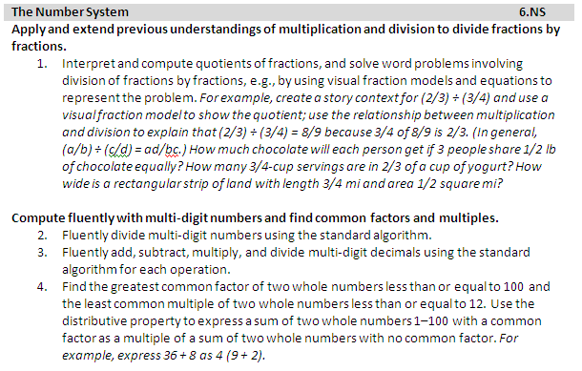
Domain
Cluster
Standards
Cluster
Notes:
26
Discuss the pieces that are seen here.
26

Slide 27
Grade Level Standards
3
“…grade placements for specific topics have been made on the basis of state and international comparisons and the collective experience and collective professional judgment of educators, researchers and mathematicians.”
-IC Mathematics, page 7
©2011 Cooperative Educational Service Agency (CESA) 7 School Improvement Services
Permission is granted to the Iowa State Department of Education for dissemination and use in any whole or part in any form within the state of Iowa region.

Slide 28
Activity 3:
Investigating the Structure of the IC Mathematics Content
Go to page 7 of the IC to review the components of the content standards structure.
See the standards provided below.
Scavenger Hunt for each standard, find all the elements (Standard #, Cluster Title, and Domain), and note them in the table below each standard.
©2011 Cooperative Educational Service Agency (CESA) 7 School Improvement Services
Permission is granted to the Iowa State Department of Education for dissemination and use in any whole or part in any form within the state of Iowa region
Notes:
Refer participants to Activity 3.
Note that the standards listed under each domain start with the number 1. In order to distinguish among the standards use the following labeling system: Grade level, Domain Abbreviation, Standard number (6.NS.3 refers to Sixth Grade, Number System, standard 3). The grade level and domain abbreviation are listed in the same line of the domain name in the IC. For seventh and eighth grade, there will also be a “grade” column
After the activity, the facilitator may want to discuss the answers that the participants should have

Slide 29
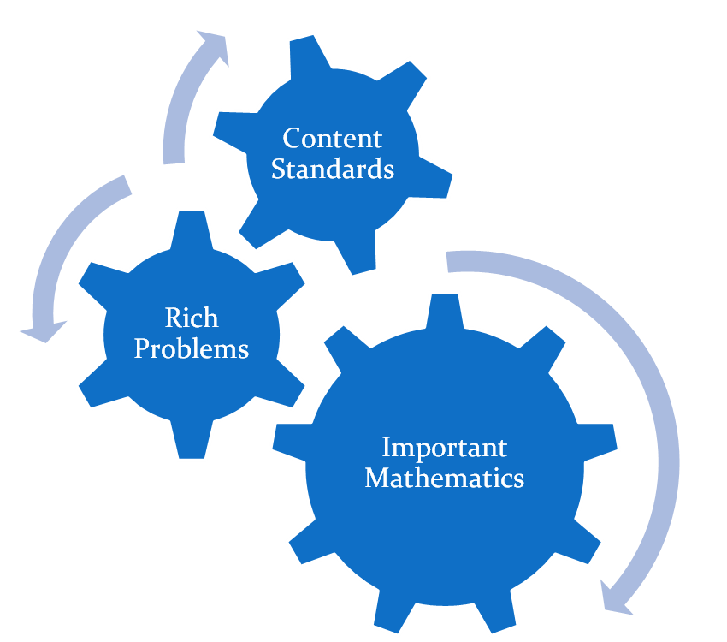

Investigating the Content Standards:
A closer look …
4
©2011 Cooperative Educational Service Agency (CESA) 7 School Improvement Services
Permission is granted to the Iowa State Department of Education for dissemination and use in any whole or part in any form within the state of Iowa region.

Slide 30
Activity 4:
Investigating Content Standards
Recall the earlier problem.
Identify the important mathematics necessary for this problem.
Identify the Content Standard(s) involved in this problem.
©2011 Cooperative Educational Service Agency (CESA) 7 School Improvement Services
Permission is granted to the Iowa State Department of Education for dissemination and use in any whole or part in any form within the state of Iowa region.
Notes:
Refer participants to Activity 4. Participants may also want to discuss the solution to the problem. The facilitator could have a group discussion at the end of this activity. (small or whole)

Slide 31
Investigating the Domains
5
Domains are common learning progressions that can progress across grade levels.
Domains do not dictate curriculum or teaching methods.
Standards within domains are not meant to be taught in the order presented.
Teachers must present the standards in a manner that is consistent with decisions that are made in collaboration with their K-12 mathematics team.
©2011 Cooperative Educational Service Agency (CESA) 7 School Improvement Services
Permission is granted to the Iowa State Department of Education for dissemination and use in any whole or part in any form within the state of Iowa region.

Slide 32
Activity 5:
Investigating the Domains
Divide the Domains as directed.
Read the Domain and note the important mathematical content
Circle or highlight what is new to your grade level.
Share out as directed.
©2011 Cooperative Educational Service Agency (CESA) 7 School Improvement Services
Permission is granted to the Iowa State Department of Education for dissemination and use in any whole or part in any form within the state of Iowa region.
Notes:
You will need to be flexible for this activity. If possible, you can do the suggested “expert jigsaw” that is delineated on the activity directions. To do so, be certain that there are at least 5 people in each table group so as to have an expert in each domain. You may have to combine/split some groups in order to do so. Assign the “number 1s” to the first domain, the “number 2s to the second domain”, etc. Direct “like numbered” participants to areas in the room to read and discuss their domain. After this discussion, participants need to return to their original group and share their knowledge.
However, you may be in a situation that this cannot be done. For example, you may have only 3 six grade teachers. Then they will have to share the 5 domains and jigsaw in their group.
Depending on time allowed, you can also have the group read a domain, share and record their thoughts, and then go onto the next—in essence each person reads all the domains at their grade level.

Slide 33
Success Criteria Check:
Poll Everywhere
To what degree do you feel able to locate your grade level content standards and explain the differences among standards, clusters, and domains?
http://www.polleverywhere.com/multiple_choice_polls/MTQzNjgxOTM3NQ

Slide 34
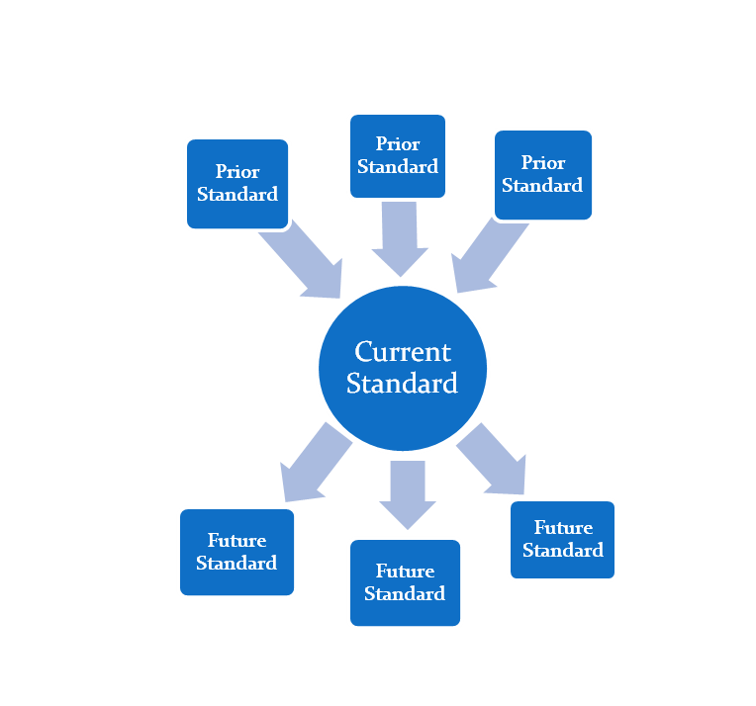
Vertical Connections
6
All Standards in mathematics have a connection to earlier and
subsequent concepts
and skills.
©2011 Cooperative Educational Service Agency (CESA) 7 School Improvement Services
Permission is granted to the Iowa State Department of Education for dissemination and use in any whole or part in any form within the state of Iowa region.
Notes:
This slide begins the introduction of Activity 6 (note the IC 6 symbol in the upper right-hand corner.)

Slide 35
K-8 Domains
Grade K
Grade 1
Grade 2
Grade 3
Grade 4
Grade 8
Grade 5
Grade 6
Grade 7
Counting & Cardinality
The Number System
Ratios & Proportional Relationships
Functions
Operations & Algebraic Thinking
Number & Operations in Base 10
Number Operations – Fractions
Expressions & Equations
Measurement & Data
Statistics & Probability
Geometry
35
35
©2011 Cooperative Educational Service Agency (CESA) 7 School Improvement Services
Permission is granted to the Iowa State Department of Education for dissemination and use in any whole or part in any form within the state of Iowa region.
Notes:
Ask the participants about anything that strikes them about this slide (new, troublesome, unique, familiar, for example). This slide will elicit a great deal of conversation. Be prepared to have a lengthy discussion.

Slide 36
Vertical Connections example
Fractions, Grades 3–6
6
Grade 3: Develop an understanding of fractions as numbers.
Grade 4:
Extend understanding of fraction equivalence and ordering.
Build fractions from unit fractions by applying and extending previous understandings of operations on whole numbers.
Understand decimal notation for fractions, and compare decimal fractions.
Grade 5:
Use equivalent fractions as a strategy to add and subtract fractions.
Apply and extend previous understandings of multiplication and division to multiply and divide fractions.
Grade 6: Apply and extend previous understandings of multiplication and division to divide fractions by fractions.
©2011 Cooperative Educational Service Agency (CESA) 7 School Improvement Services
Permission is granted to the Iowa State Department of Education for dissemination and use in any whole or part in any form within the state of Iowa region.
Notes:
Ask the participants about anything that strikes them about this slide (new, troublesome, unique, familiar, for example).
36

Slide 37
Coherence
6
William Schmidt and Richard Houang (2002) have said
“…a set of content standards must evolve from particulars to deeper structures inherent in the discipline. These deeper structures then serve as a means for connecting the particulars.”
IC Mathematics page 4
©2011 Cooperative Educational Service Agency (CESA) 7 School Improvement Services
Permission is granted to the Iowa State Department of Education for dissemination and use in any whole or part in any form within the state of Iowa region.

Slide 38

6-8 Connection: Statistics and Probability
6
6th | 7th | 8th
2. Understand that a set of data collected to answer a statistical question has a distribution which can be described by its center, spread, and overall shape. 3. Recognize that a measure of center for a numerical data set summarizes all of its values with a single number, while a measure of variation describes how its values vary with a single number. | 4. Use measures of center and measures of variability for numerical data from random samples to draw informal comparative inferences about two populations. For example, decide whether the words in a chapter of a seventh-grade science book are generally longer than the words in a chapter of a fourth-grade science book. | 4. Understand that patterns of association can also be seen in bivariate categorical data by displaying frequencies and relative frequencies in a two-way table. Construct and interpret a two-way table summarizing data on two categorical variables collected from the same subjects. Use relative frequencies calculated for rows or columns to describe possible association between the two variables.
©2011 Cooperative Educational Service Agency (CESA) 7 School Improvement Services
Permission is granted to the Iowa State Department of Education for dissemination and use in any whole or part in any form within the state of Iowa region.
Notes:
38
Ask the participants about anything that strikes them about this slide (new, troublesome, unique, familiar, for example).
38

Slide 39
H.S. Connections: Geometry
6
8th Grade | High School
1. Verify experimentally the properties of rotations, reflections, and translations: Lines are taken to lines, and line segments to line segments of the same length. Angles are taken to angles of the same measure. Parallel lines are taken to parallel lines. | Experiment with transformations in the plane 2. Represent transformations in the plane using, e.g., transparencies and geometry software; describe transformations as functions that take points in the plane as inputs and give other points as outputs. Compare transformations that preserve distance and angle to those that do not (e.g., translation versus horizontal stretch). 3. Given a rectangle, parallelogram, trapezoid, or regular polygon, describe the rotations and reflections that carry it onto itself. 4. Develop definitions of rotations, reflections, and translations in terms of angles, circles, perpendicular lines, parallel lines, and line segments. 5. Given a geometric figure and a rotation, reflection, or translation, draw the transformed figure using, e.g., graph paper, tracing paper, or geometry software. Specify a sequence of transformations that will carry a given figure onto another.
©2011 Cooperative Educational Service Agency (CESA) 7 School Improvement Services
Permission is granted to the Iowa State Department of Education for dissemination and use in any whole or part in any form within the state of Iowa region.
Notes:
As done earlier, have the participants comment about what they see---

Slide 40
Watch this clip….
Planning and results----
What is the value of learning progressions?
http://www.youtube.com/watch?v=bggFBWn7YoI

Slide 41

Fractions Progression
6
K-2
3-5
6-8
Equal Partitioning
Rates, Proportional and Linear Relationships
Unitizing in Base 10 and in Measurement
Rational Number
Number line in Quantity & Measurement
Fractions
Properties of Operations
Rational Expressions
©2011 Cooperative Educational Service Agency (CESA) 7 School Improvement Services
Permission is granted to the Iowa State Department of Education for dissemination and use in any whole or part in any form within the state of Iowa region.
Notes:
Diagram is not explicit to what is taught in grade level (for example, properties of operation does not end in grade 2), but rather shows what learning must take place prior to grade 2 to enable fraction learning in grade 3 and beyond.

Slide 42
Functions & Equation Progression
6
Quantity and measurement K-5
Ratio and proportional relationships
6-7
Operations and algebraic thinking
K-5
Functions
8-12
Expressions and Equations
6-8
Modeling (with Functions)
9-12
Modeling Practices K-12
©2011 Cooperative Educational Service Agency (CESA) 7 School Improvement Services
Permission is granted to the Iowa State Department of Education for dissemination and use in any whole or part in any form within the state of Iowa region.
Notes:
42

Slide 43
Activity 6:
Investigating Vertical Connections
Given the standards in the chart, find corresponding prior and future standards (if they exist) that focus on the learning progressions. Go only one level above and one level below the given standard.
Discuss and note these connected standards in the chart.
©2011 Cooperative Educational Service Agency (CESA) 7 School Improvement Services
Permission is granted to the Iowa State Department of Education for dissemination and use in any whole or part in any form within the state of Iowa region.
Notes:
Give participants a chance to discuss their findings.

Slide 44
Activity 7:
Investigating Mathematical
Understanding
Begin a “line of learning” by responding to this question:
What is the meaning of
“mathematical understanding?”
Notes:
Prior to beginning this activity, explain to the participants what a line of learning is (see the notes below this chart). If participants want more information, tell them that this is included in the facilitation notes.
This activity is more facilitator guided. A “line of learning” is a “quick write”. Give the participants 1 minute to write their response the meaning of “mathematical understanding” signaling them to stop and then proceed to number 1. The problems in number 1 are variations of those used in NAEP with 11th graders (content at 6th grade level). The NAEP information is found below the chart.
You may want to have participants share the problems they created and why they fit the example/non-example. End this part with continuing the line of learning (1 minute). Continue onto number 2 (individual reading and writing).

Slide 45

Math Class Needs a Make Over
Dan Meyer
High School Math
Teacher
http://www.ted.com/talks/dan_meyer_math_curriculum_makeover.html
Notes:
Number 3 is a video from Dan Meyer (11:39 in length). Information on the video follows the chart. After the video, do a final line of learning writing. Do number 4.

Slide 46

In short, a lack of understanding
effectively prevents a student
from engaging in
the mathematical practices.
Iowa Core Mathematics, p. 10
46

Slide 47
Success Criteria Check:
Poll Everywhere
To what degree do you feel able to describe "mathematical understanding" by giving an example and a non-example?
http://www.polleverywhere.com/multiple_choice_polls/LTcwMzcwNDcxMQ

Slide 48
Success Criteria Check:
Poll Everywhere
To what degree do you feel able to describe how Iowa Core Mathematics Standards provide a structure to change teaching and learning?
http://www.polleverywhere.com/multiple_choice_polls/LTQ4MjUyNzUwNA

Slide 49
Determining Implications and Next Steps
We’ve been investigating the standards – now, what do we do?
©2011 Cooperative Educational Service Agency (CESA) 7 School Improvement Services
Permission is granted to the Iowa State Department of Education for dissemination and use in any whole or part in any form within the state of Iowa region.

Slide 50
Activity 8:
Reflection
In the chart, reflect on the activities completed by responding to these prompts
New things I learned about the IC Mathematics based on Practices, Content, and Miscellaneous items.
Next Steps for how you will take this process back to your colleagues for investigations at your School/District.
©2011 Cooperative Educational Service Agency (CESA) 7 School Improvement Services
Permission is granted to the Iowa State Department of Education for dissemination and use in any whole or part in any form within the state of Iowa region.
Notes:
Refer participants to Activity 9.
Ask participants to complete Activity 9 individually. Then participants should share one new thing they learned about IC Mathematics with their small group. After group sharing, encourage some to share with the large group.

Slide 51
Success Criteria:
I can explain at least two of the standards for mathematical practice.
I can describe the critical areas for my grade level.
I can locate my grade level content standards and explain the differences among standards, clusters, and domains.
I can describe “mathematical understanding” by giving an example and non-example.
Notes:
Participants need to judge their learning against the success criteria.

Slide 52

Feedback
Please complete the exit ticket provided.
Thanks so much for your participation! Best of luck!
Contact:
Your AEA Math Consultant
©2011 Cooperative Educational Service Agency (CESA) 7 School Improvement Services
Permission is granted to the Iowa State Department of Education for dissemination and use in any whole or part in any form within the state of Iowa region.
Notes:
Participants need to fill out and then leave their exit ticket.

