Slide 1



Deeper Investigations of the Standards:
Iowa Core Mathematics
Grades 6 – 12, Day 2
March 1, 2013
SW Consortium
Iowa Department of Education
In Partnership with
AEA School Improvement
Notes:
1
1
If you want, point out the backing of both DE and AEA in this work for the IC

Slide 2

Welcome…
… from your feedback last time…

Slide 3

Things you never hear about Reading and Writing…..
Notes:
How many times have you heard this phrase – instead aimed at math versus ELA?
“My mom can’t do math and that is why I can’t either.”
Everyone gets a slip of paper with a phrase on it.
Roam the room: If someone said that statement to you, as it is written, why would it be a ridiculous statement; yet when it is said about math, we empathize?
And, instead, make a statement in return about what we can do collectively to stop that.
What double standards are we creating by letting these comments slide for math and not for ELA?
I hate math because…
Why does this matter: there are number of research articles that indicate students will not try to learn math, if their parents struggled with it – they are defeated before they even begin.

Slide 4

Iowa Core Mathematics Journal
OMJ
Notes:
Journals will be handed in at the close of class today for everyone.
Download the journal at mathaea8.weebly.com under Deeper Investigations – scroll all the way to the bottom.

Slide 5

Think About Our Last Session
Notes:
Go to next slide…for activity

Slide 6


What have we done so far?
First Turn, Last Turn
Read your journal entries from the last meeting
One person in the group reads one big idea from his/her journal
In round-robin fashion, everyone can comment on that idea, with the originator having the last turn
Repeat around the table
Notes:
Find your journal from last time….
Although the slide shows the directions, the facilitator needs to go through these extended directions for First Turn, Last Turn:
Groups of 4 to 8. Silently and simultaneously read your journal entries and highlight a few items that have particular meaning for you
Select a person to start each group.
This member shares one of their highlighted items but does not comment on it.
In round-robin fashion, each of the other group members comments about the identified item with no cross-talk
Then the initial person who named the item now shares his or her thinking about the item and therefore, gets the last turn.
Repeat this process for each group member until everyone gets the last word
Stress that there is no cross-talk. Explain that when cross-talk occurs it takes focus off of the speaker, changes the topic, and diminishes the speaker’s influence.

Slide 7
OMJ
Learning Goals for
“Deeper Investigations” Professional Development
Understand that the structures of the Iowa Core Mathematics are meant to support focus and coherence
Understand that fluency, deep understanding, application and dual intensity support rigor
Understand how to investigate the Iowa Core Mathematics
Notes:
These are the goals for this day’s work for the participants here.
Developing a set of learning goals for a course takes what faculty know but don’t always state and puts it into a short list of real concepts that can guide participants and add clarity to teaching and learning.

Slide 8
Success Criteria
OMJ
1. I can describe 6 of the standards for mathematical practice.
2. I can connect the critical areas for my grade level to the specific standards at my grade level.
3. I can explain the big ideas of content within the domains/conceptual categories at my grade level.
4. I can describe “mathematical understanding” by explaining how teacher questioning supports it.
5. I can describe how Iowa Core Mathematics provides a structure to change teaching and learning.
Notes:
Explain that these will appear again at the end of the day. At that time, you will see if you have met them or are part way there.

Slide 9

Recall your personal learning goals written in your journal…
Notes:
JOURNAL:
ARE THESE STILL TRUE OR DO THEY NEED TO BE EDITED?
ANY THING ACCOMPLISHED TOWARD THESE GOALS? IF SO, MAKE NOTE!
Thinking about all the goals that you have written, plus all of the ones we have designed, hopefully we can start to detemine that this work cannot be completed in the 3 days that we are together, we need to prioritize what needs to happen first…second…third. Take the goals that have been shared and talk to your partners at your table and try to come up with a chronological order for these goals.

Slide 10

Supporting Rich Mathematical Tasks
Notes:
Finding tasks are part of the work of teachers, but another part of the work is putting them into action.
How does a teacher support the use of rich tasks with their actions?
On the board:
Keep track of all the considerations a teacher must make to teach in this fashion.
-Find a task
-Match to standard(s) or critical area(s)
-Ensure cognitive complexity match
-Be sure the task is ‘rich’
-Figure out where the task belongs within the unit
-Determine which mathematical practices can be taught/used through the task
-Draft teacher questions

Slide 11

Intent of the standards
A curriculum is more than a collection of activities: It must be coherent, focused on important mathematics and well articulated across the grades.
Notes:
A curriculum is more than a collection of activities: It must be coherent, focused on important mathematics and well articulated across the grades.
Discussion: Curriculum coherence requires a focus on interconnections, or big ideas. Big ideas represent fundamental principles; they are the ideas that link the specifics.
Val – I added this:
students differ in a classroom it is usually in terms of specifics or certain skills and not the big idea – we need to be sure we know what the generalizations are when we plan the unit, once we know the big ideas, then we can start to determine ways to differentiate our lessons to meet the needs of all students. Again, we need to determine the big ideas first, then plan tasks that support all learners.
For example, the notion that benchmark numbers are a way to make sense of other numbers is equally useful for the 6th grader who is trying to place -22 on a number line, the 8th grader who relates pi to the number 3.14…If students differ in a classroom it is usually in terms of specifics or certain skills and not the big idea.
Big ideas can form a framework for thinking about important mathematics and supporting standards driven instruction.
A.SSE.3 for HS
8.F.2 for MS
Sheila Added: Our goal is to determine the intent of this standard, but we don’t want any standard to be a stand alone, it will always be with a group of standards as you address the unit. But, it serves us well to begin reading the standards this way. Find the standard – what conceptual category is it in? What is it’s cluster heading? Go to page 8 in the appendix A and find when it can be taught. What course is it recommended for? Any other course?
Result: by the end of this course, students should have a deep understanding of what? What is the intent of this standard? What will students know, understand and be able to do as a result of this standard?
Have table discussion to determine the intent of the standard: Leave it kind of loose as far as directions – just state, what is the intent of the standard, then, put out the standards insight tool for this one standard and ask: does this KUD express exactly the intent, or would you like to modify the KUD to better reflect your understanding of the intent. Have them spend a few minutes to complete this.
If they need guidance, we could do something like:
Read the standard
2. Identify the Intent – what is the understanding that students need to be able to transfer to future mathematics?
3. Identify the Cognitive Complexity

Slide 12
Dilemma
Notes:
One cannot and should not look at each standard in isolation.
Read Aloud: paragraph about Grecian Urn
Then,
By giving the task today, and spending too much time on this one standard, we may give the impression that the Core should be taught this way. So, we need to pause and talk about how it is important to know what each standard says, but in it’s relation to the other standards the cluster and domain it is connected to and the cluster and domains themselves. If we isolate the standards, then we run the risk of isolating and or forgetting the mathematical practices. This then becomes similar to what has been done in the past with NCTM’s process standards.
So, it is important to look at the domain/conceptual category as a whole and understand what the domain/conceptual category is trying to achieve.
Read Bill’s Blog and then Kansas handout: Have them share out their thoughts as they read this with their elbow partner – may want to do !, ?, …

Slide 13

A Task
Notes:
Complete the problem
Give them time to work the problem
Remember the purpose of the problem is to help make that standard we just read come to life and for the standard to start to have meaning.
Table discussion:
To what degree does this task match the intent of the standard we considered before doing the task?
A.SSE.3 for HS
8.F.2 for MS
Are there other standards to which this task is linked?

Slide 14
Is it a Rich Mathematical Task?
Rich mathematical tasks:
Emphasize connections across mathematical content areas, to other disciplines, and especially to the real world
Are accessible yet challenging to all
Can be solved in several ways
Encourage student engagement and communication
Encourage the use of connected multiple representations
Encourage the appropriate use of intellectual, physical, and technological tools
“Not all tasks are created equal, and different tasks will provoke different levels and kinds of student thinking.”
Stein, Smith, Henningsen, & Silver, 2000
Notes:
Pass out the checklist (Yellow Cardstock )
And ask them to determine if it is a rich task? Ask them to rank those checklists almost. Which ones are strong and which are weak?
Do all components need to be met, if so, how can the problem be revised so that all can be met?

Slide 15
Where does this fit within a unit?
By teaching through rich mathematical tasks, students develop deep conceptual understanding and skill proficiency.
Why is it important to let students work on a math task without first showing them how to solve it?
http://ifl.lrdc.pitt.edu/ifl/index.php/resources/ask_the_educator/ido_jamar/
Notes:
mathematical tasks cannot be defined as being a task unless they push learning the new content through the problem. So we cannot determine if the task is rich unless we know where the problem falls in the unit
Read this aloud:
A teacher’s goal must be to help students understand mathematics; yet understanding is not something that one can teach directly. No matter how kindly, clearly, patiently, or slowly teachers explain, they cannot MAKE students understand. Understanding takes place in the students’ minds as they connect new information with previously developed ideas, and teaching through problem solving is a powerful way to promote this kind of thinking. Teachers can help and guide their students, but understanding occurs as a by-product of solving problems and reflecting on the thinking that went into those problem solutions. For that reason, this book is all about teaching and learning mathematics through problem solving. By solving problems, students learn to make connections among mathematical ideas.
Page 11 of Teaching Mathematics through Problem Solving, NCTM
Just Give to them: Have them read chapter 3 Teaching though problem solving …
Give them the new problem on playgrounds (HS) and Val …and ask them to see which problem would be easier to teach the content through…

Slide 16
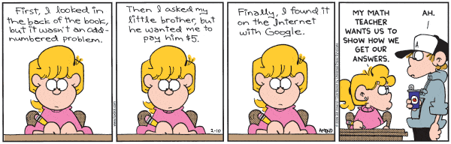
How does the task connect with the Standards for Mathematical Practice?
Notes:
Review 1 to 4 if necessary.
Discuss at the table how this task connects with the mathematical practices 6 and 7. Then review quickly 1 to 4 and see if any would be appropriate. Be sure each person has a turn discussing.

Slide 17
Standards for Mathematical Practice
Make sense of problems and persevere in solving them
Reason abstractly and quantitatively
Construct viable arguments & critique the reasoning of others
Model with mathematics
Use appropriate tools strategically
Attend to precision
Look for and make use of structure
Look for and express regularity in repeated reasoning
17
17
©2011 Cooperative Educational Service Agency (CESA) 7 School Improvement Services
Permission is granted to the Iowa State Department of Education for dissemination and use in any whole or part in any form within the state of Iowa region.
Notes:
Our goal today is to add two more Mathematical practices to your repertoire.

Slide 18

Think-Pair-Share
At your table, half of people will read Mathematical Practice 6, the other people will read Mathematical Practice 7
Those reading the same Practice will discuss the big ideas from the reading
Those reading the same Practice will discuss connections to the problem
The whole table will share their findings

Slide 19
How can you scaffold understanding with questions?
After having engaged in the task, write questions to use Before, During and After students engage in the task.
“In practice, students actual opportunities for learning depend, to a considerable degree, on the kind of discourse that the teacher orchestrates. The nature of the activity and talk in the classroom shapes each students’ opportunities to learn about particular topics as well as to develop her or his abilities to reason and communicate about those topics.”
-Henningsen & Stein, 1997
Notes:
Pass out bookmark resource on questioning. Ask: What do you notice about these questions? (is that right?)
Use the bookmark as a source –
I might provide this question for the HS problem:
If students have difficulty getting started on the task, you might ask, “Just by looking at the four expressions, (a)–(d), without doing any computation, can you
tell me one thing that you know about the flight of the horseshoe?”
Wait on this I think…
In the flipcharts on our homepage, we can look at misconceptions that might need to be addressed in our questioning…
JOURNAL
WHAT POINTS DO YOU WANT TO REMEMBER ABOUT TEACHER QUESTIONING?

Slide 20

An Example…
http://www.pd360.com/index.cfm?ContentId=6114
Notes:
THESE ARE PD 360 VIDEOS – YOU’LL NEED TO LOG IN TO VIEW THESE!!!
On the slide is the MS video:
http://www.pd360.com/index.cfm?ContentId=6114
8th grade linear equations, focusing on 8.EE.8 and MP.4-6
HS Video:
http://www.pd360.com/index.cfm?ContentId=6116
Usefulness of systems of equations, focused on A-REI.7 and MP.2 & 6

Slide 21

What’s the elephant in the room?
What are you wondering about implementa-tion of what we’ve been talking about?
Notes:
How long do I let students struggle before stopping and teaching how to do the problem?
How often do I do problems like this?
What is the difference between using problems and teaching through problem solving?
JOURNAL
WHAT ARE YOU WONDERING ABOUT IMPLEMENTATION OF WHAT WE’VE BEEN TALKING ABOUT? AND, WHAT IS YOUR CURRENT ANSWER?

Slide 22
Your turn
Choose standards which are connected in your curriculum
Determine the intent of the standards
Find task(s)
Judge whether it is a rich task
Link to Standards for Mathematical Practices
Create questions that help to foster deep understanding
Notes:
Question: I am examining algebra conceptual category and you are in eqn’s and exp??
Do you like this as is…

Slide 23
Resources to use
Finding Tasks:
  www.nctm.org
  http://illustrativemathematics.org/
  http://insidemathematics.org/
  http://nctm.illuminations.org/
  http://www.smarterbalanced.org/
  http://bit.ly/13s0Ed3 (Dan Meyer’s 3-Act Math Task)
  http://mathaea8.weebly.com/
Google the standard notation you are interested in (ex. 8.NS.2 CCSS )
Notes:
Need to develop how this looks!
Have them do some problems from the flip charts, from the domain/concept catecory that we want them to think about.
Then give them the flip chart and read through it – then they could examine how the problem they did relates to the standard that they are working on.
I don’t think most of these would be considered a rich task, so then they could look for a rich task that addresses more than one standard and gets them to start thinking about how the standards might be “arranged” in their curriculum.
At this point, drop the college and career readiness – we won’t be able to come up with enough for each standard, I am wondering if we do something at the end that pulls them together with one example of this….yikes

Slide 24
Poll Everywhere Check
To what degree are you able to describe the role of teacher questioning in building mathematical understanding?
http://www.polleverywhere.com/multiple_choice_polls/NjU0Nzk0OA
Notes:
We haven’t used “mathematical understanding” as a vocabulary word so far on these slides.

Slide 25
Modeling
Quickly Review Mathematical Practice #4
Read Conceptual Category on page 73 and 74.
Compare the two and discuss why this is a stand alone concept category at the High School level.
Notes:
Have them meet someone new!
Ask if they remember how to tell if a standard, a cluster heading, or even a domain is considered to be “modeled”

Slide 26
Journal
Summarize the 2 standards of mathematical practices (#6 and #7) you have just explored.
How does having modeling as a conceptual category impact your teaching?

Slide 27
Poll Everywhere Check
To what degree do you feel able to describe 6 of the Standards for Mathematical Practice?
http://www.polleverywhere.com/multiple_choice_polls/LTY2NzM2NjY

Slide 28

Algebra
6
Solve this problem, and then we will use this as an entry point to help us understand the Algebra Standards.
Solve this system:
Compare your solution with a neighbor’s solution. Describe other possible solution methods.
Notes:
Participants should get that x = 7 and y = -4.
Solution methods include, tables, graphs, substitution method, elimination method, matrices, etc.

Slide 29
Algebra Activity – Pair
6
Work and Discuss with a Neighbor:
  At what grade level and in what course is this problem and topic typically taught?
  Examine the Iowa Core Mathematics document to find out where this topic appears in the standards.
  Based on this key example, discuss the transition from middle to high school with regard to Algebra, particularly as it relates to the study of linear equations, equations of lines, and systems of linear equations.
Notes:
Most participants will likely say that this material – solving systems of linear equations, is taught in high school in Algebra I. But in Iowa Core Mathematics, solving systems of linear equations, both algebraically and graphically is now in Grade 8.
In addition, the y = mx + b equation of a line is also part of middle school mathematics.
So now, almost all the time in high school that was spent on solving linear equations, linear functions, equations of lines, and systems of linear equations is now done in middle school. This will be a big change for many districts.

Slide 30
Algebra Activity – Whole Group
6
How is Iowa Core Algebra different from the algebra curriculum currently in place in your district?

Slide 31
Algebra I
8th grade looks a lot like Algebra I, so what is Algebra I now?

Slide 32
Iowa Core Mathematics Transition for Algebra I
Traditional Curriculum in Iowa
Iowa Core Curriculum
7th Grade
8th Grade
Algebra 1
Geometry
Algebra 2
7th Grade
8th Grade
Algebra 1
Geometry
Algebra 2
Notes:
This shows the comparison between our traditional Algebra I courses and the newly adopted Iowa Core. In particular, how they relate to Algebra 1 course. You can see that a large portion of what we currently teach in Algebra I will now be taught in the Iowa Core 7th and 8th grade courses. And some of what we currently teach h in Algebra 1 will still be taught in Algebra 1. There are some things we currently teach that is no longer in the Iowa Core and we do not need to teach. That leaves a lot of room in the algebra I course.

Slide 33
Iowa Core Mathematics Transition for Algebra I
New Standards
Algebra 2
Statistics
Probability
Pre-Calculus
Algebra 1
Geometry
7th Grade
8th Grade
Algebra 1
Geometry
Algebra 2
Notes:
Some things we currently teach in Algebra 2 will now be taught in Algebra 1 and a small portion of probability and Statistics will be taught in Algebra I. Then we have some new standards that will finish our Algebra I course.

Slide 34
Iowa Core Algebra 1
New Standards
Statistics/Probability
Traditional Algebra 1
Algebra 2
Algebra 1
Iowa Core Standards
Notes:
So here is the comparison between what we have been teaching and our new Iowa Core Algebra I course.
I have probably talked with your or high school teachers at your district about NCTMs push for Algebra for ALL students.
This was when we were talking mostly about Algebra I when it was Linear Algebra.
Now the bar is very much raised.
Now we’re not only talking about algebra concepts past linear, but statistics and probability, functions, and so on.

Slide 35
Algebra: Conceptual Category
Digging in and looking a little closer at this category!
Notes:
Hand out the Algebra handout – each table needs to take one of the 4 domains and read through these. Fill in chart paper this table and share out – 10 min to complete – 5 minutes to present.
Count off by 4’s
Ones will do first Domain…

Slide 36
Algebra Journal Entry
What are the changes that will need to occur in your district for the Algebra Conceptual Category in order to be implemented fully?
What are some concepts or skills do you currently teach that will be moved out of the course you currently teach?

Slide 37
Poll Everywhere
To what degree do you feel able to connect the Algebra Standards to your HS courses?
http://www.polleverywhere.com/multiple_choice_polls/MTc3MzkxODkxNw

Slide 38
Functions
Introduction:
“Functions” is now a conceptual category (strand), in addition to Algebra.
“Functions” begin with the Grade 8 standards.
Notes:
Just note these points as the introduction to Functions.

Slide 39
K-8 Domains and HS Conceptual Categories
Grade K
Grade 1
Grade 2
Grade 3
Grade 4
Grade 8
Grade 5
Grade 6
Grade 7
Grade 9-12
Counting & Cardinality
Standards for Mathematical Practice
Number & Operations in Base 10
The Number System
Number &
Quantity
Operations & Algebraic Thinking
Expressions & Equations
Algebra
Number Operations – Fractions
Ratios & Proportional Relationships
Functions
Modeling
Measurement & Data
Statistics & Probability
Geometry
39
39
©2011 Cooperative Educational Service Agency (CESA) 7 School Improvement Services
Permission is granted to the Iowa State Department of Education for dissemination and use in any whole or part in any form within the state of Iowa region.

Slide 40
Functions Activity
Use the discussion questions on the first page and discuss
  The common instructional sequence
  The discussion questions
After your table is finished discussing all the questions on page one, turn to page two and read silently.
After reading the second page, discuss each of the headings.
  The “typical answers”
  Turning the conventional sequence upside down
  The “conventional approach” versus the “functions approach”
Notes:
Use the two-page handout for the Activity.
Page 1 has the sequence of tasks and four discussion questions. This page needs to be done separately and before Page 2.
Page 2 has “the answers” to the discussion questions, along with important conclusions.

Slide 41
Functions
Let P=(0,1) and Q=(1,2) in the (x,y) plane.
Show that there is a unique linear function described by the equation y=mx+b whose graph contains P and Q: find m and b.
  Go to pages 68 and 69
Show that there is a unique exponential function described by the equation y=ab^{x} whose graph contains P and Q: find a and b.
Show that there is more than one quadratic function described by the equation y=ax²+bx+c whose graph contains P and Q.
Notes:
Read page 69 to begin. Then start the problem
Spend a few minutes on this problem. The purpose is to determine the mathematics involved. Go to overview page on functions in standards book. Read the Domains/Clusters and see if you determine which standards are addressed in this problem. Which of the practice standards are addressed in this activity that you would want your students to concentrate on. Is this a rich task?

Slide 42
Functions
Using Appendix A: page 10 and 11 and Content Standards : page 68 – 72
Read those standards pertaining to either Alg. 1 or 2
  Discuss at your table what would stay the same in your district and what would need to change. What has been added, what has been deleted?
Notes:
Change tables around so that they will mix it up…
I do a model of this
Have them make a list of standards that would need to be added, and another that would need to be deleted. Partner up to do the walk through of these standards.

Slide 43
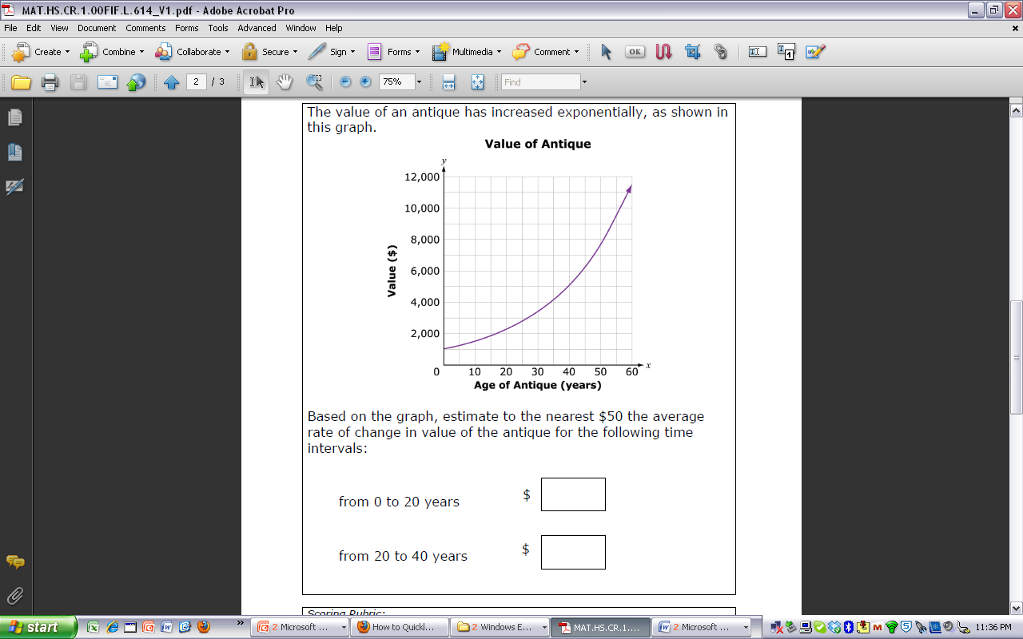
Notes:
This is a Balanced Assessment problem. Where would you put this in the standard and the mathematical practices

Slide 44
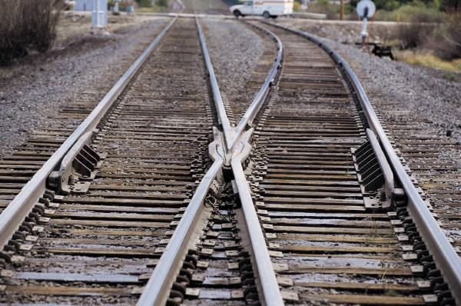
Functions Journal Entry
If we think of the domains as being like rails, then we also have to be able to see the ties or “Big Ideas "that bind the rails together.
What are the rails you see between Algebra and the Functions domains?

Slide 45
Poll Everywhere
To what degree do you feel able to connect the Function Standards to your HS courses?
http://www.polleverywhere.com/multiple_choice_polls/ODYzMTc1Njkx

Slide 46
Geometry
It is the only Conceptual Category (Domain for K-8) that spans all through K-12.
This Conceptual Category has 3 Iowa Added Standards
  We will spend our time on the Iowa Added Standards

Slide 47
Iowa Core Math – Networks
8
Geometry – Modeling with Geometry
(IA) Use diagrams consisting of vertices and edges (vertex-edge graphs) to model and solve problems related to networks.
  IA.8.Understand, analyze, evaluate, and apply vertex-edge graphs to model and solve problems related to paths, circuits, networks, and relationships among a finite number of elements, in real-world and abstract settings.★
  IA.9.Model and solve problems using at least two of the following fundamental graph topics and models: Euler paths and circuits, Hamilton paths and circuits, the traveling salesman problem (TSP), minimum spanning trees, critical paths, vertex coloring.★
  IA.10.Compare and contrast vertex-edge graph topics and models in terms of: properties, algorithms, optimization, and types of problems that can be solved.★
Notes:
This begins the overview of vertex-edge graphs.
THIS OVERVIEW, WITH AN ACTIVITY, WILL TAKE ABOUT 20 MINUTES.
Don’t dwell on this slide. Just display and read the cluster title (IA) and then the next slides will investigate and provide elaboration.
The * notation means that these standards are particularly relevant to mathematical modeling.

Slide 48
Let’s do a little problem!
Notes:
Hand out Optimum Communication Network problem
Have them do it with a new partner

Slide 49
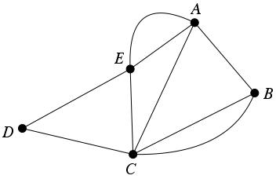
Understand the Networks Standards
What is a network or vertex-edge graph?
What kinds of problems can be solved with vertex-edge graphs?
What are some important vertex-edge graph topics?
Notes:
These are the questions that will be briefly considered in the next slides.

Slide 50
What are vertex-edge graphs?
8
Diagrams consisting of
vertices (points) and edges
(segments or arcs) joining
some of the vertices
Used to model and solve
problems related to networks, paths, and relationships among finite number of objects
Called: vertex-edge graphs, graphs, networks, discrete graphs, or finite graphs
Part of discrete math—math for computer science
Part of geometry—geometric figures in which connections are crucial, not size and shape
B C
A D
G
F E

Slide 51
Solve problems like these, using these topics:
8
Find the best route for snowplowing, garbage collection, newspaper delivery, visiting customers, or collecting money from ATM machines
  Euler Paths, Hamilton Paths, Traveling Salesman Problem
Find the best network within a system of roads, for a network of computers, or in a communication network
  Minimum Spanning Trees
Notes:
This slide and the next slide show the types of problems that can be solved, and the particular vertex-edge graph topics that can be used to solve the problems.
Go through this slide briefly, more details and an example follow.

Slide 52
Solve problems like these, using these topics:
Avoid conflicts when scheduling committee meetings, storing chemicals, designing zoo habitats, or coloring maps
  Vertex Coloring
Manage large projects to finish on time, like construction projects, publishing the school newspaper, or putting on an event
  Critical Paths
Notes:
This and the previous slide show the types of problems that can be solved, and the particular vertex-edge graph topics that can be used to solve the problems.
Go through this slide briefly, more details and an example follow.

Slide 53
Example: Critical Path – PERT
Consider a large project that consists of many smaller tasks, e.g., build a house.
Some of the tasks can be done at the same time, some are prerequisites for others.
What is the least amount of time needed to finish the entire project?
Consider building a house …
Notes:
See specific example on the next slide.

Slide 54
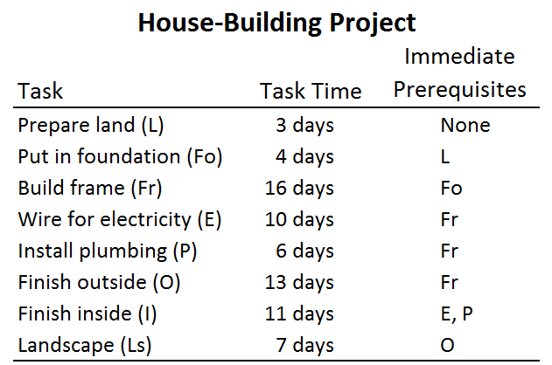
8
Notes:
Here is the description of the house-building project.
In the next few slides, you will discuss the set-up of the problem. Then participants will solve the problem.

Slide 55
What is the least time needed to build the house?
Must complete all the tasks.
Assume you have as many separate crews as needed.
Find the minimum time needed to finish the house.
Before solving, think about mathematical modeling and in the classroom ….
Notes:
Clarify the problem.

Slide 56
How do we solve this problem?
8
Build a model: vertex-edge graph
  Task → Vertex
  Task time → Weight (number) on the vertex
  Prerequisites → Arrows between vertices
Use the mathematics of vertex-edge graphs to solve the problem.
Note: This is Mathematical Modeling.
Notes:
Discuss the general strategy for solving the problem.
Note the process of mathematical modeling, which is an important part of the Iowa Core Mathematics standards.

Slide 57
In the classroom…
8
Guide and encourage students to:
  Build a model
  Try methods for solving the problem
  Explain how their method works
  Explain why their method gives a solution to the problem
For us and for now, go straight to the model…
Notes:
Emphasize the meaningful active-learning problem-solving approach to take in the classroom.
In our professional learning setting with limited time, we will go straight to the model, on the next slide.

Slide 58
For now, do…
8
Use the model on the next slide to solve the problem:
What is the minimum time needed
to build the house?
Explain your method.
Explain why your solution gives the minimum time needed to build the house.
Notes:
Now the participants solve the problem. See the project graph on the next slide.

Slide 59
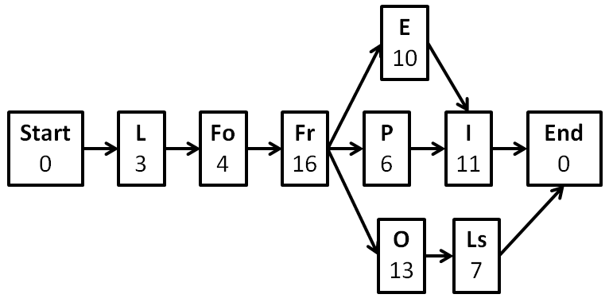
Model: Vertex-Edge Graph
8
Notes:
Let participants work on the problem and discuss. The solution is given on the next slide.

Slide 60
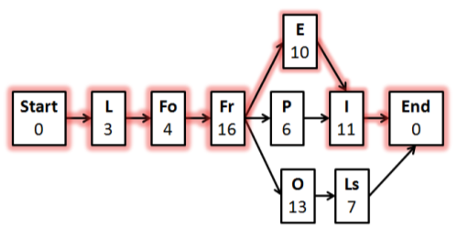
What is the Solution and
What is the Math?
8
Path with longest length gives
the minimum time needed to
finish the house
  Called a critical path
Tasks on critical path are
called critical tasks.
  If you get behind on them, you get behind on whole project.
Technique used to find a longest path is called the PERT technique
  Widely used in business and industry
Notes:
A path through the project graph that has longest length gives the minimum time needed to finish the house. A longest path is called a critical path.
The tasks on a critical path are called critical tasks. They are “critical” because if you get behind on them you get behind on the whole project.
The technique used to find a longest path is called the PERT technique. This is a widely-used application in business and industry.

Slide 61
Deeper Investigation of Vertex-Edge Graphs
Engage in a student task, solve, discuss
Discuss readings from NCTM
Optional additional tasks
Notes:
Overview of the deeper investigation of vertex-edge graphs.

Slide 62
Vertex-Edge Graphs: Task
Task: Find an Optimum Communications Network (handout).
Solve
Discuss
Notes:
Facilitator can use the Teacher/Facilitator Notes (handout) to carry out the task with participants engaged as students.

Slide 63
Vertex-Edge Graphs: NCTM
Additional Resources:
Read the handout from NCTM Navigations: Vertex-Edge Graph Topics and Applications.
Core Math Tools
Notes:
Handout and have partners or groups read and discuss the one-page description from the NCTM Navigations book on
“Vertex-Edge Graph Topics and Applications.”

Slide 64
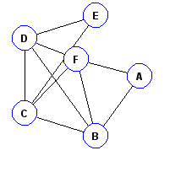
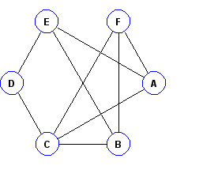
From Core Math Tools
Advanced Apps
  Two sample graphs given!
Not -Euler Graph
Euler Graph

Slide 65
Journal for Geometry
Provide some options as to where your district will include these Iowa Added Standards. Name some potential issues with your suggestions.

Slide 66
Poll Everywhere
To what degree do you feel able to connect the Geometry Standards to your HS courses?
http://www.polleverywhere.com/multiple_choice_polls/LTEzNDY1MTg1NDI

Slide 67
Standards of Mathematical Practices
North side of the table will Read Mathematical Practice #5
  Create at your table a chart of what the teacher what the teacher will be doing, what the student will be doing, and what are good questions for the teacher to ask.
South side of the table will read Mathematical Practice #8
  Create at your table a chart of what the teacher what the teacher will be doing, what the student will be doing, and what are good questions for the teacher to ask.
Notes:
Provide questions from IPTV…
Keep to 20 to 25 minutes total!!
Make everyone read both standards before they move around the room. Move around the room and share with someone you have not worked with yet. Be sure to give concrete examples…
Need a North and South symbol somehow so people will mix up…

Slide 68





Number and Quantity

Slide 69
Number and Quantity
The Real Number System
Rational Exponents
Rational and Irrational
Quantities
Reason
Voting
Information Processing
Notes:
On page 61, read IA.3 and the cluster heading

Slide 70
Understand and apply the math of voting
Common Voting Methods and Analysis
Majority and Plurality
Run-off
Approval
So-Called Instant-Runoff (IRV)
Borda
Condorcet
Quick and easy analysis
Notes:
After they have read the quantities domain, Cluster heading of Understand and apply the mathematics of voting and the list of voting /analysis methods:
Pass out the different sheet on voting
What the difference between runoff and instant runoff voting??
What is instant runoff voting?
Instant Runoff Voting is a system that guarantees the winning candidate has a majority of the votes (instead of a plurality) and eliminates the "wasted vote syndrome" caused by third party candidates. It allows voters to rank the candidates by preference on a single ballot (first, second, third choice, etc.), so it can simulate an "instant" runoff election if no candidate has a majority of the votes.
What is a runoff election?
A runoff election is sometimes (rarely) held when there are three or more candidates and none of them won a majority of the votes. It's another election between just the two top vote getters, held weeks after the first election, at great expense, and usually with a lower voter turn-out.
At 3:15 Borda method discussed Borda method of 4 choices, ranks with 1st place w/ 3 pts, to 0pts

Slide 71
Math of Voting – Example
8
We’re stopping for lunch during a field trip.
Everyone must eat at the same restaurant.
Where should we eat? How to decide?
Vote, but use ranked-choice voting
Choices are Subway, KFC, and McDonalds.
Data from ranked-choice voting shown on the next slide.
Notes:
In the classroom, students could actually vote, organize the data, and think about winners. For now, in this PD session, the data are given in the next slide. We will spend time analyzing the data.

Slide 72
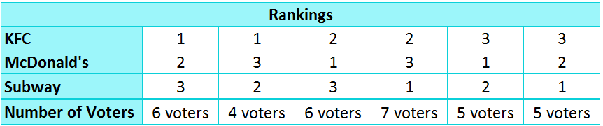
Lunch Vote
8
Why should Subway win?
Why should Subway not win?
Why should KFC win?
Why should McDonald’s win?
Notes:
It is important to organize data in a useful manner. In the classroom, you would spend time working with students to build this table.
For now, make sure everyone understands the table. For example, the last column means that 5 voters have Subway as their first preference, McDonalds as their second preference, and KFC as their third preference.
Let participants think about and discuss the questions above. Some suggested answers are on the next slide.
RANKED CHOICE is done so we can analyze the voting using different method….
Subway would win if we used plurality…
There are 6 + 4 voting for KFC for 1st place
There are 6 + 5 voters for McDonalds for 1st place
Thereare 7 + 5 voters for Subway for 1st place

Slide 73
Lunch Vote
8
Why should Subway win?
  most 1st preference votes (7+5=12) (plurality)
Why should Subway not win?
  most 3rd preference votes (6+6=12)
Why should KFC win?
  Least 3rd preference votes (5+5=10)
Why should McDonald’s win?
  Runoff top two—McD’s and Subway—and McD’s has most 1st

Slide 74
Analysis Methods
8
Plurality
Runoff
  run off the top two candidates
Condorcet Method
  each pair run off head-to-head
Instant Runoff Voting (IRV)
  sequentially eliminate the lowest vote-getters, until one has a majority
Borda Method
  assign points for preferences
related: Approval Voting
  Vote for everyone of whom you approve
Notes:
Now that we’ve seen an example, let’s consider the methods listed in the voting Standard.
Plurality and Runoff were seen in the previous restaurant voting example.
Just brief descriptions now. Don’t worry about details at this time. Details are in other materials from the DE, and/or in later professional development.
Note that Approval Voting is not ranked-choice voting, nor an analysis method. It is another way to vote, by voting for everyone of whom you approve. Then the winner is the candidate who gets the most votes.

Slide 75
Key Points
8
Plurality winner can be (and often is) the candidate who is least preferred by the most voters! That’s just not fair!
Different methods can produce different winners.
Is there a perfect method?
  No – Arrow’s Impossibility Theorem
What to do?
  Plurality is the worst (when ≥ 3 candidates).
  Experts prefer …
    Borda (Saari)
    Approval (Brams)
    IRV (2011 London School of Economics conference)
Notes:
Donald Saari is a mathematician whose research points to the Borda method. Stephen Brams is a political scientist whose research points to the Approval method. A conference on voting at the London School of Economics in 2011 supports the IRV method and designates plurality as the worst.

Slide 76
Benefit of Ranked-Choice Voting
8
U.S. mid-term elections, November 2010
(from FairVote.org)
Democrats spent $15,000 on a mailer to targeted households identifying a third-party candidate as the true conservative candidate in the race.
Republicans fielded Green Party candidates in Arizona.
Why use these strategies?
To siphon votes from the main opponent in the major rival party. This exploits the weakness of non-ranked-choice voting when there are 3 or more candidates.
Can such campaigning be avoided?
Yes, use ranked-choice voting.
Notes:
This and the next slide point out some recent events in which ranked-choice voting would be helpful. You might scan current news, or look at fairvote.org, to find other more current events. (Note: clicking on FairVote.org will take you to its website.)

Slide 77
Benefit of Ranked-Choice Voting
8
Presidential elections in France & Egypt
Spring 2012
Both were close contests, with several viable candidates
No candidate received a majority of votes in the first round of voting, so by law a run off is required.
Run-off elections are expensive
and typically have low turnout.
Can they be avoided?
Yes, use ranked-choice voting.

Slide 78
Ranked-Choice Voting in the US and throughout the World
8
For example, ranked-choice voting is used in:
  Australia
  Ireland
  London
  Minneapolis
  Memphis
  San Francisco
  Colorado
  North Carolina … see Newsweek article (next slide)

Slide 79
Electoral Experiment in North Carolina
8
By McKay Coppins, Newsweek, October 24, 2010
“The logic of general elections is simple: winner takes all. This, of course, can encourage nasty campaigning—and at the end of a race with more than two candidates, the victor often wins with only a plurality (not a majority) of support. Searching for a solution, a handful of cities have experimented with an alternative approach, in which voters rank candidates in order of preference. If no one receives more than half of the first-place votes, a winner is picked by tallying second and third choices. (You may not get your first pick, but chances are the winner won’t be your worst nightmare.)”
“On Nov. 2, this approach will be used for the first time in a statewide election. It’s a small race—North Carolina court of appeals judge—but proponents hope it will encourage the more than 20 states that have mulled the system since 2000.”
Notes:
If wanted, the URL is http://www.thedailybeast.com/newsweek/2010/10/24/north-carolina-tries-instant-runoff-voting.html. (Note: clicking on “Newsweek” will take you there.)
Remainder of the article, if wanted: “The biggest hurdle has been electronic voting machines, which mostly lack compatible tabulating software. But where instant runoffs have been tested, they’ve softened the tone of campaigns. Second place, it turns out, does count for something.”

Slide 80
Some Resources for
Teaching the Voting Standard
8
Online module
  resourceiowa.org
  Complete and ready for classroom use
Free software
  National Council of Teachers of Mathematics (NCTM)
  → Core Math Tools
  www.nctm.org/coremathtools/
  Go to Advanced Apps → Ranked-Choice Voting
Notes:
You might decide to explore these resources now, or wait and explore later in this PD session. (Note: clicking on the URLs will take you to the websites.)

Slide 81
Iowa Core Math – Voting
8
Number and Quantity – Quantities
(IA) Understand and apply the mathematics of voting.
  IA.3. Understand, analyze, apply, and evaluate some common voting and analysis methods in addition to majority and plurality, such as runoff, approval, the so-called instant-runoff voting (IRV) method, the Borda method and the Condorcet method.
Notes:
This ends the discussion of the Voting Standard.

Slide 82
Journal Number and Quantity
Discuss your own personal teaching experience with the various voting methods. If you have not taught any of these before, what more will you need to be successful?

Slide 83
How can you scaffold understanding with questions?
After having engaged in the task, write questions to use Before, During and After students engage in the task.
“In practice, students actual opportunities for learning depend, to a considerable degree, on the kind of discourse that the teacher orchestrates. The nature of the activity and talk in the classroom shapes each students’ opportunities to learn about particular topics as well as to develop her or his abilities to reason and communicate about those topics.”
-Henningsen & Stein, 1997
Notes:
Pass out bookmark resource on questioning. Ask: What do you notice about these questions? (is that right?)
Use the bookmark as a source –
I might provide this question for the HS problem:
If students have difficulty getting started on the task, you might ask, “Just by looking at the four expressions, (a)–(d), without doing any computation, can you
tell me one thing that you know about the flight of the horseshoe?”
Wait on this I think…
In the flipcharts on our homepage, we can look at misconceptions that might need to be addressed in our questioning…

Slide 84
Poll Everywhere Check
To what degree do you feel able to describe 8 of the Standards for Mathematical Practice?
http://www.polleverywhere.com/multiple_choice_polls/LTEwOTQyNDQzOTc
84
84

Slide 85

Transitioning to the Iowa Core
The Iowa Core for Mathematics requires a change in when we teach content… so what will we do about that?

Slide 86
Learning Goals for
“Deeper Investigations” Professional Development
CFW
Understand that the structure of the Iowa Core Mathematics are meant to support focus and coherence
Understand that fluency, deep understanding, application and dual intensity support rigor
Understand how to investigate the Iowa Core Mathematics
Notes:
Revisit the goals for today, but also ask the students to look at any personal goals that they wrote in their journals.

Slide 87
Success Criteria
CFW
1. I can describe 6 of the standards for mathematical practice.
2. I can connect the critical areas for my grade level to the specific standards at my grade level.
3. I can explain the big ideas of content within the domains/conceptual categories at my grade level.
4. I can describe “mathematical understanding” by explaining how teacher questioning supports it.
5. I can describe how Iowa Core Mathematics provides a structure to change teaching and learning.
Notes:
Revisit the success criteria for today, but also ask the students to look at any success criteria that they wrote in their journals. At this point you can ask the participants for a signal as to how successful they were (for example, thumbs up, down, or sideways).

Slide 88
Give us feedback about your learning
3 Things you learned today
2 Things you will use
1 Question you still have

Slide 89
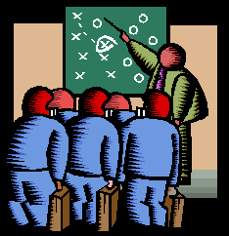
Feedback Survey
http://survey.aea.k12.ia.us/f/94656/ac2a/

Slide 90

See you …
CFW
Thanks so much for your participation!
Notes:
Suggest that people use their IC journal between now and next meeting to continue to record questions, comments, and new learning that enhances their learning.

